Slide 1
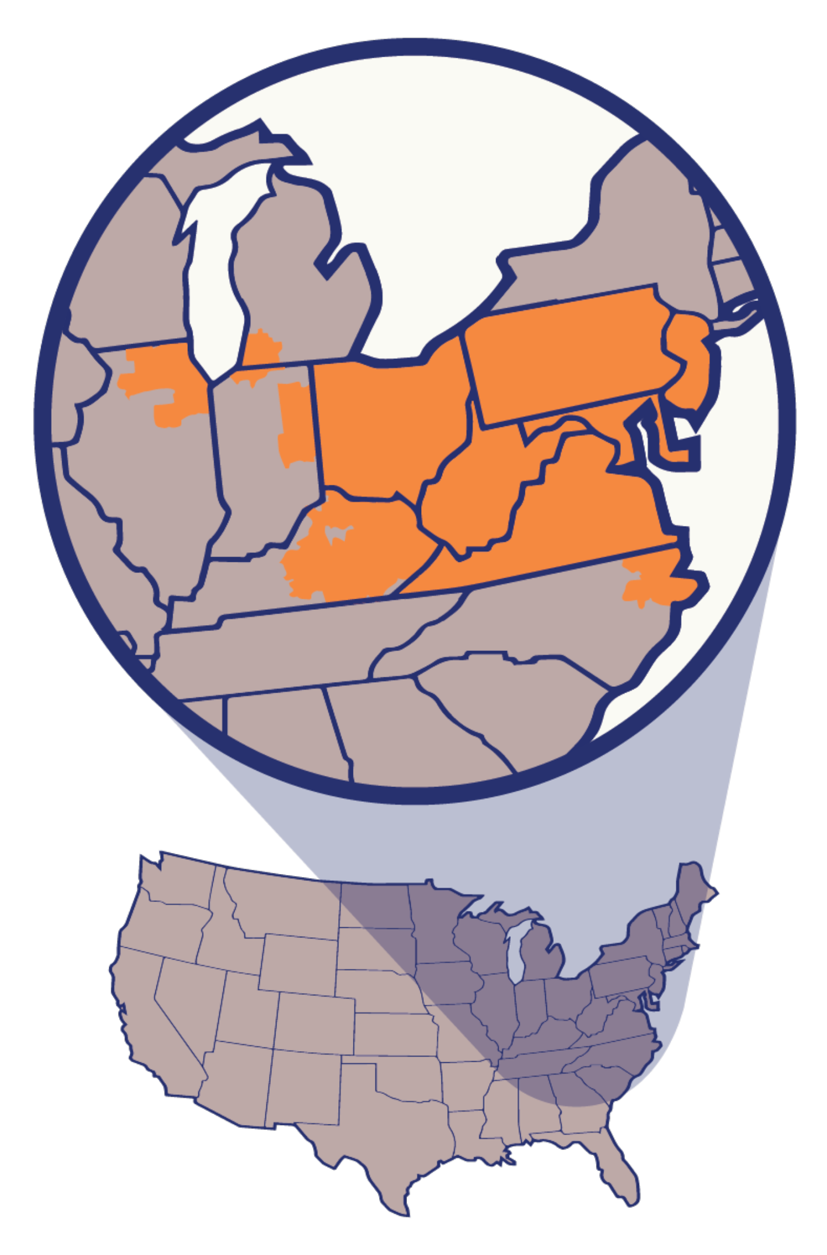
PJM
OVERVIEW

Slide 2
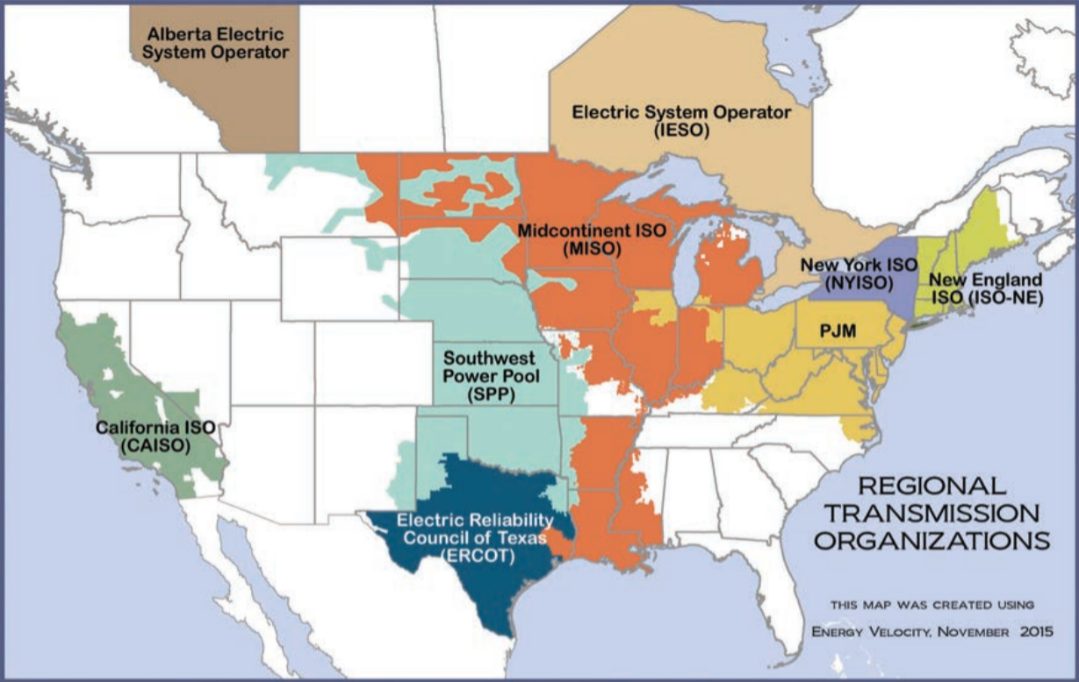
Notes:
Just to start at a very high level, this map shows the regions covered by the different “regional transmission organizations” in the U.S. and Canada. In the U.S. there are seven, and PJM covers the mid-Atlantic and Ohio Valley area. About 65 million people in portions of 13 states and the District of Columbia. PJM operates the largest competitive wholesale market for electricity in the US, and globally is only second in size to the European Integrated Energy Market.

Slide 3
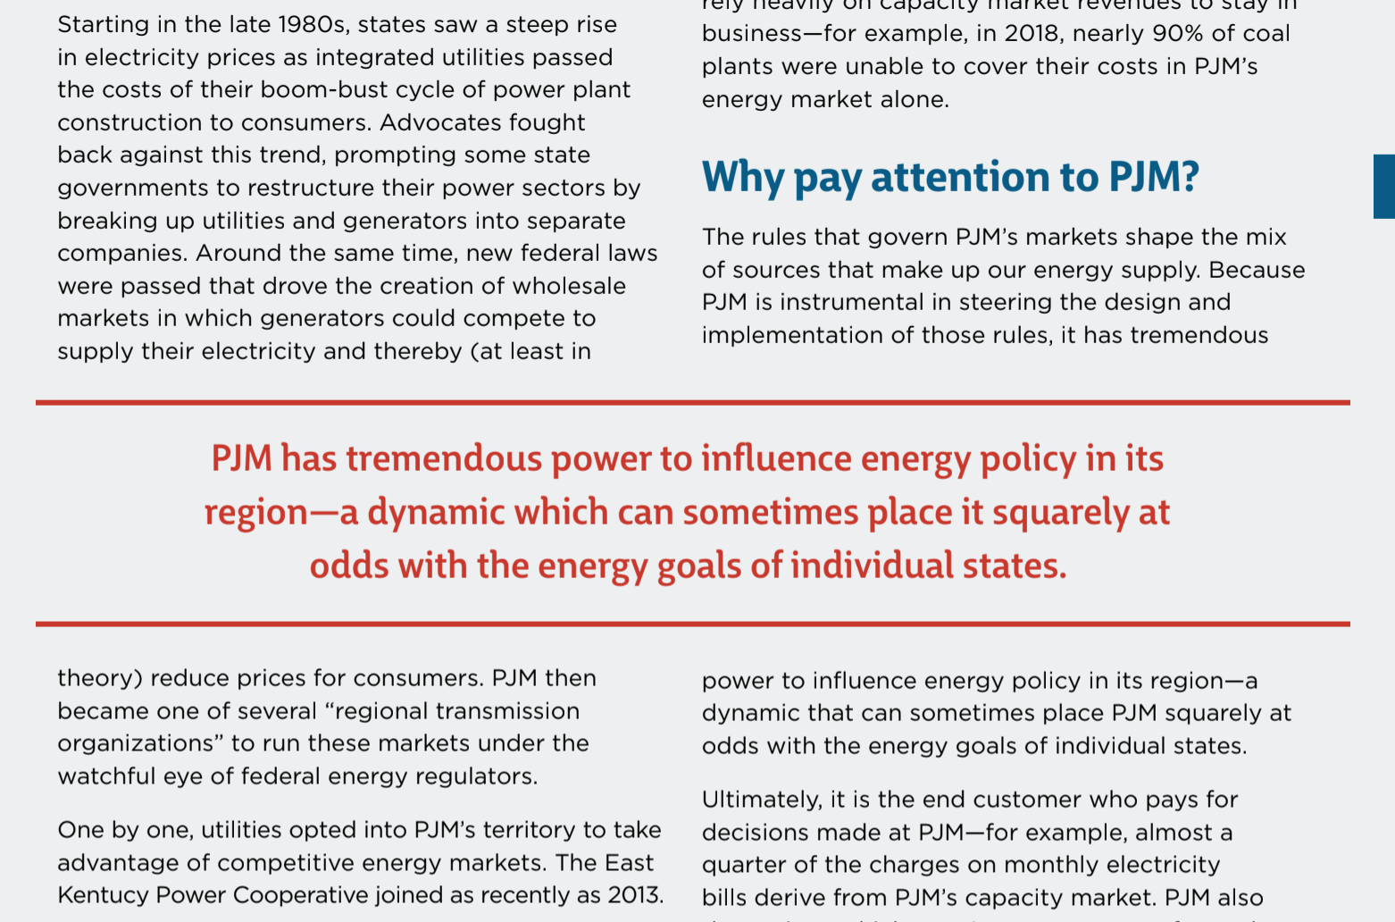
Notes:
PJM became a regional transmission organization a few decades ago when states restructured their energy sectors to break up utilities that had monopoly control and ownership over generation of power (power plants) and transmission and distribution of power to people’s homes and businesses. That monopoly structure had led to a lot of concern around excessive prices and costs being forced onto consumers.
As owners of generation were separated out from distribution utilities, competitive wholesale markets were set up for generators to compete with each other to sell power, with the idea being that competition would help lower costs. PJM in its current form was created to run these markets and oversee a regional grid.

Slide 4








Grid operator role
Notes:
PJM has a couple of core mandates. One is transmission. So not the individual low-hanging power lines that you see on your neighborhood residential streets, but rather the high up high-voltage lines that carry power long distances within and across states. These are the lines that start at power plants and end at local utilities which then handle the distribution lines in the counties, towns and cities they serve.

Slide 5

Notes:
This is an image of the control room at PJM headquarters in Valley Forge, Pennsylvania. It’s deep underground and heavily guarded given obvious sensitivity. So here we see another aspect of PJM’s role, which has to do with balancing – ensuring that across the system supply of electricity is always matched up with demand in real time.

Slide 6
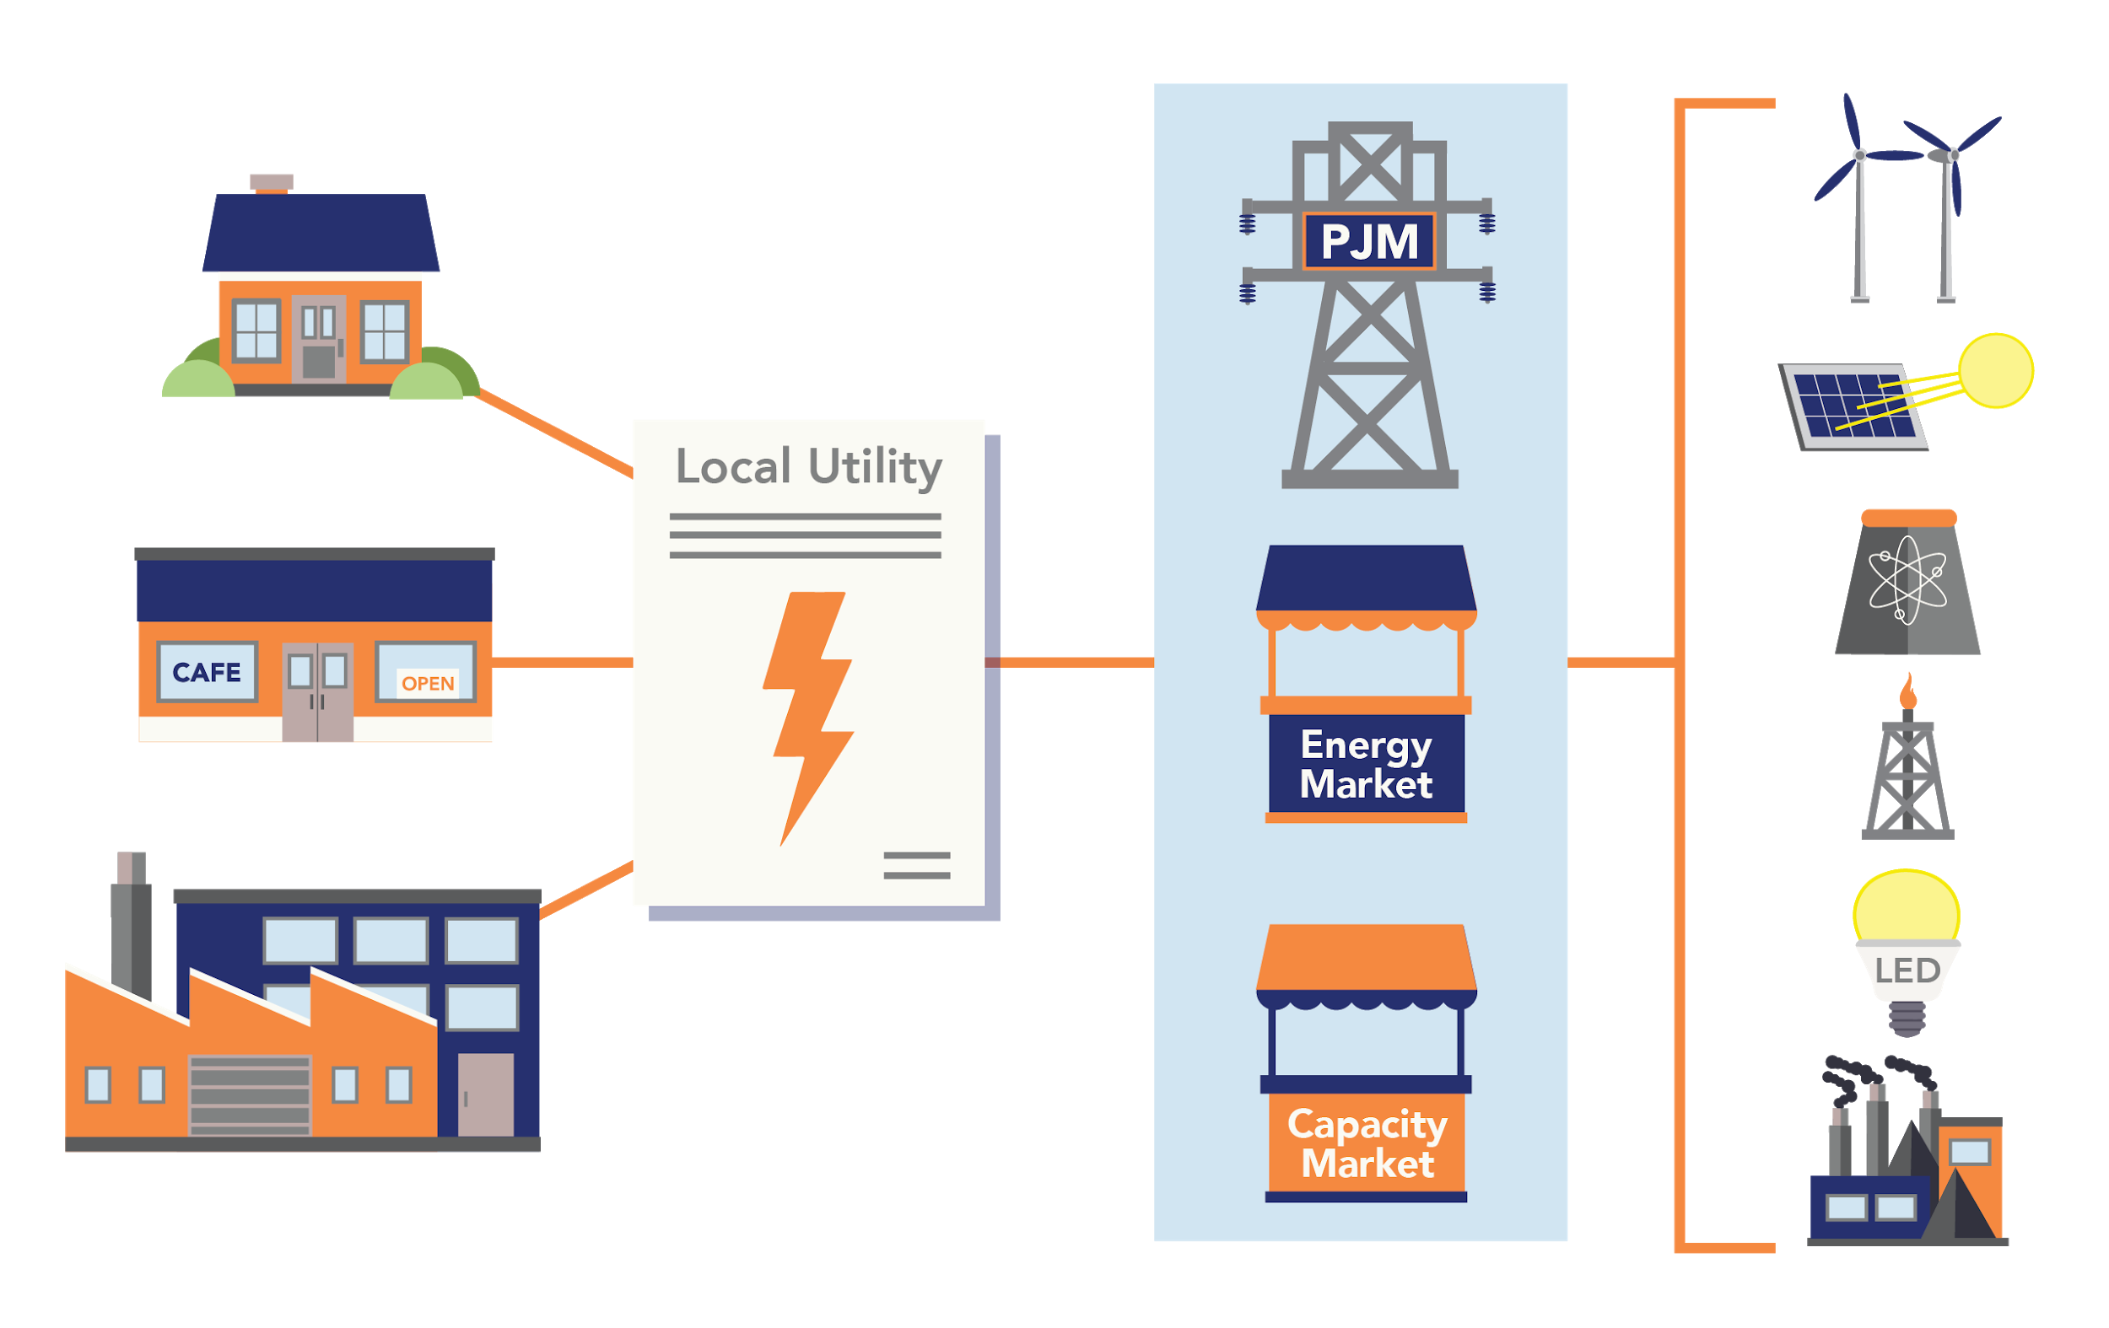
Wholesale markets operator role
Notes:
And finally, as we mentioned earlier, PJM also has a role running the wholesale markets where owners of power plants and other types of power generations compete to sell their energy. There are a couple basic types of markets PJM runs – energy markets where sources compete constantly to meet the very near-term minute by minute or one-day-ahead energy needs, and the capacity market, where source compete just once a year to get payments for agreeing to meet our future energy needs a couple years down the road. Think of the capacity market like an added layer of insurance – paying companies in advance so they’ll build or maintain their generation facilities to be there ready and functioning in 2-3 years. As we see in this graphic, sources on the right sell into PJM’s markets, which in turn sell to local utilities, which in turn sell to residential and commercial customers.

Slide 7
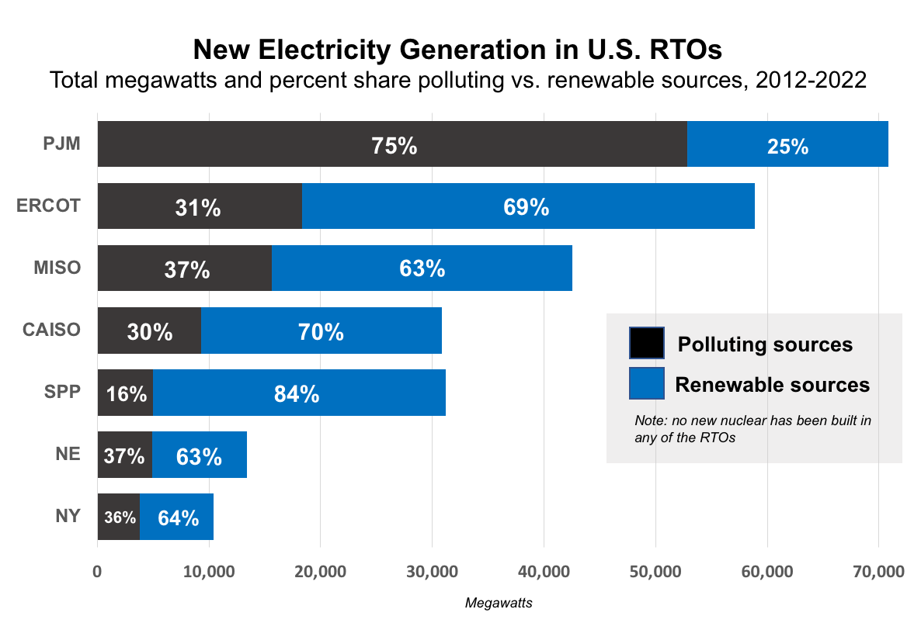
Notes:
Ok, so now that we have a basic overview of what PJM is let’s take a look at why they matter so much for anyone who cares about which energy sources we’re building and using to power our world nowadays, and how much consumers are paying. On this slide we see a comparison of the 7 RTOs in the US – the ones we saw on our opening slide. And what’s shown in the black and blue portions of each bar is the percent of new electricity generation built in their market that polluting vs. clean, going back to 2012 and also including what will be built through 2022. No nuclear has been built or will be built in PJM’s region, and the same is true of coal, so what we’re seeing here in the black portions of the bars is gas, and the blue is solar and wind.
So in PJM about three-quarters of what’s been built is gas vs. about a quarter renewables – and that stands out in very stark contrast to all the rest of the RTOs in the country. At ERCOT in Texas, for example, it’s virtually the opposite – nearly three quarters renewables and just over a quarter gas. And the story is similar right on down the line, at MISO (Midcontinent), at CAISO in California, at the Southwest Power Pool etc.

Slide 8
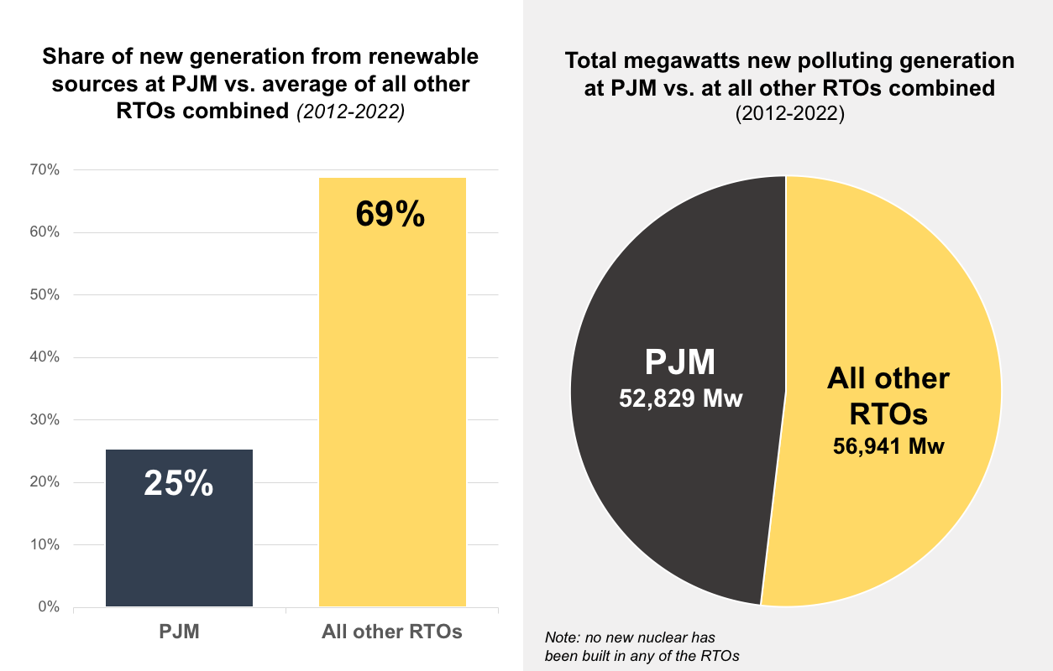
Notes:
Here are some summary way’s of looking at this same data. On the left hand side of this slide we see that the average share of new generation coming from renewables at all the other RTOs in the country is 69% -- compared to 25% at PJM. And in the pie chart on the right, we see that just about as much new gas generation has been built in PJM as at all the other RTOs combined.
So what’s going on here?

Slide 9
Capacity market pays sources for our future energy needs.
Capacity = 21% of generation costs on average household bill (about $140/yr)
“At PJM, the capacity market has become a tool for uneconomic fossil fuel power plants to get paid enough to stay alive”
Notes:
In order to unpack this we need to go back to the markets PJM runs, and in particular the capacity market – the one where owners of sources compete to meet future energy needs. The costs in this market end up being about 20 percent of the total generation costs for residential customers on their household electric bill, about $140 a year on average. The quote at the bottom of this slide is from a Utility Dive op-ed by NRDC: “At PJM, the capacity market has become a tool for uneconomic fossil fuel power plants to get paid enough to stay alive.” So that’s the problem here. ERCOT, for example, doesn’t have a capacity market. MISO doesn’t have a capacity market like PJM’s.

Slide 10
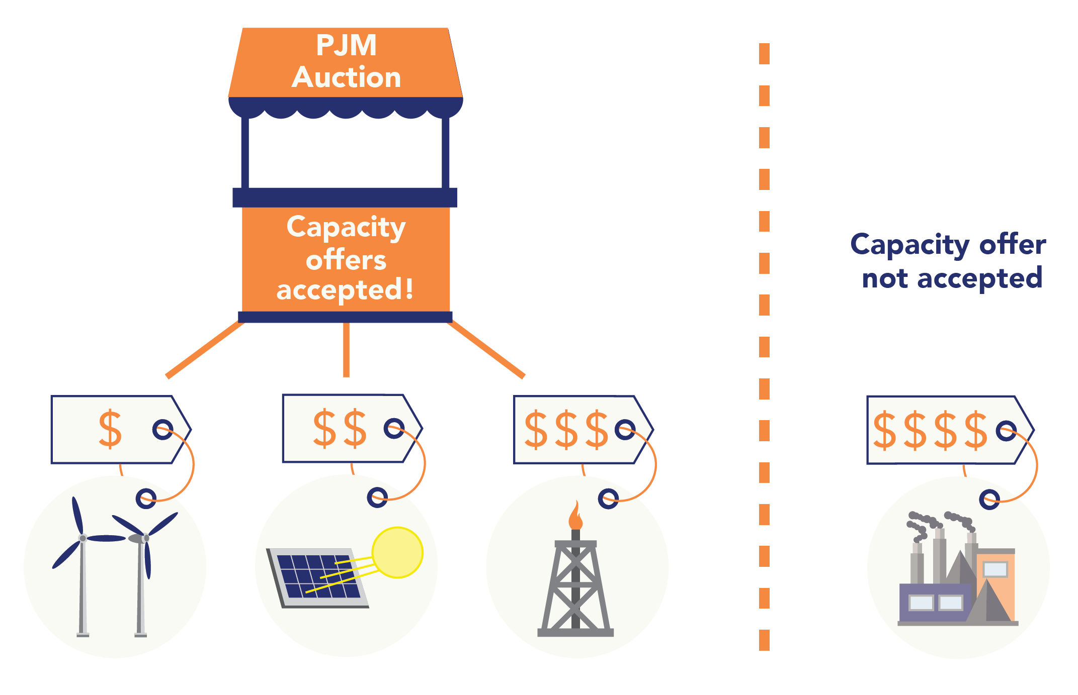

Slide 11
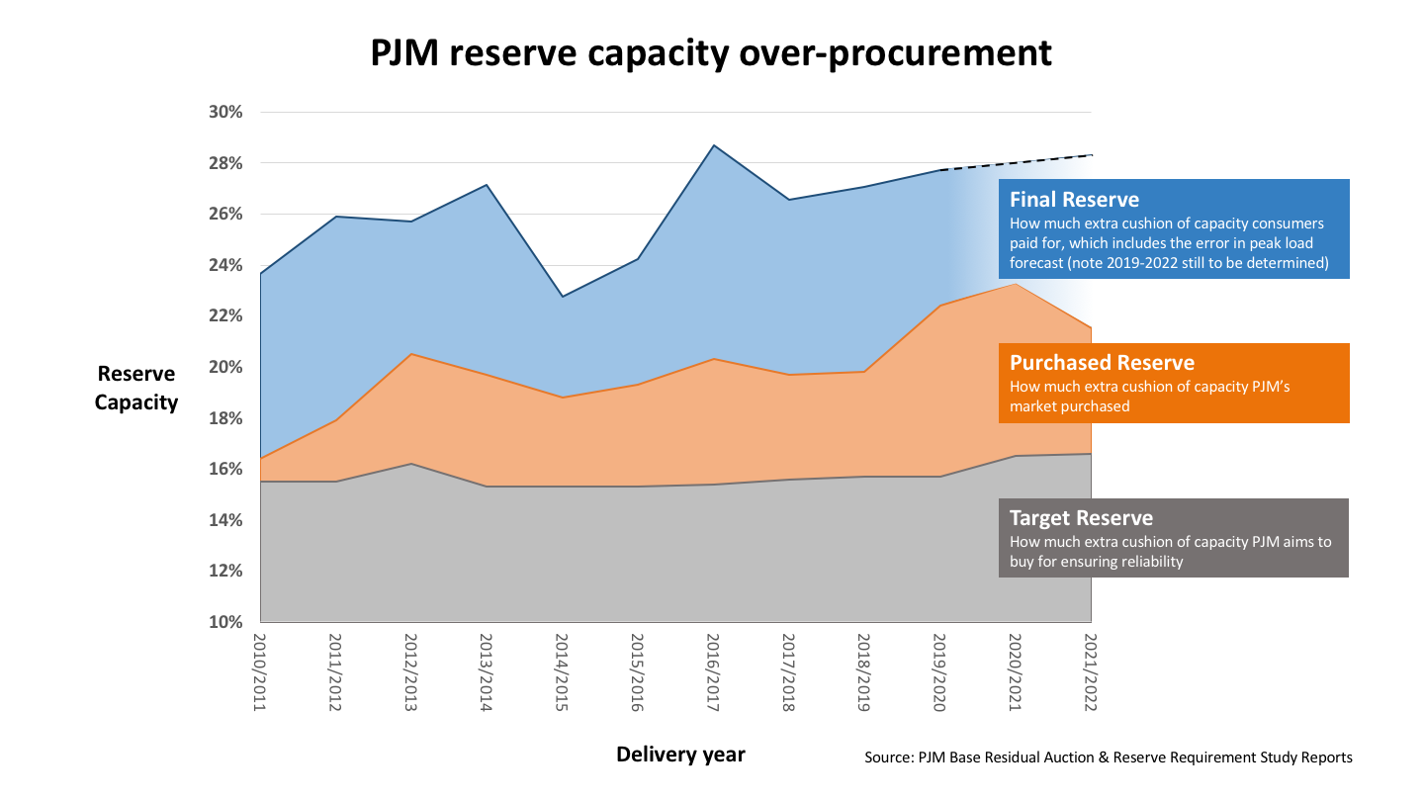
One key to help fossils stay alive is to
keep buying too much capacity
Notes:
Let’s look at two of these details in this market that are counterveiling winds to the nice theory of how things are supposed to work – and end up simply helping more expensive fossil fuel plants stay afloat and costing customers money for no reason. Here’s the first one -- the matter of how much total extra capacity PJM’s market is procuring. Remember how we said that PJM sets a “clearing price” for capacity and then all the sources that offer at or under that price get sell their capacity and get paid? Well, it turns out that the way PJM sets this clearing price is ending up buying a heck of a lot more capacity that is actually needed – allowing a whole bunch of more expensive fossil fuel plants to have their capacity accepted than is actually needed.
In this graph, the grey band at the bottom is how much extra cushion of capacity PJM determines is actually needed to be purchased in its annual capacity market in order to be totally sure there will be more than enough power generation online in three years to handle any possible worst-case scenario and still keep the lights on for all – about a 15% cushion of “reserve capacity.” The orange band shows how much additional extra cushion PJM’s markets have actually purchased each year (18-23%), because of the way they set their clearing price. And then then blue band shows how much extra cushion of capacity consumers have actually ended up having to pay for in the end. So all this extra unneeded “fat” in the capacity market is one key way that more expensive fossil fuel plants have continued to be able to get paid even though their capacity isn’t actually needed.

Slide 12
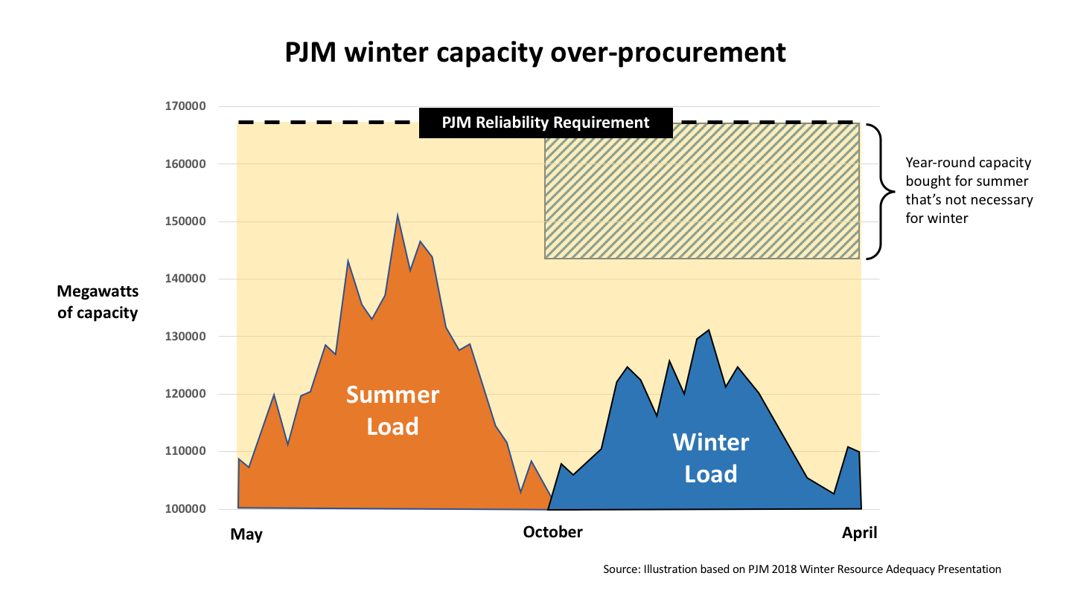
Another is skewed rules like “all year round” requirements that favor fossil plants
Notes:
Now here’s another of the devilish details in the capacity market – a rule that favors fossil fuel plants by requiring that owners of generation sources can only offer capacity into the market that they can guarantee all year-round, 365 days a year. Obviously that disadvantages a solar farm, which can generate more in the summer, or a wind project, which can generate more in the winter – forcing them to have to dial back what they can sell in the capacity market and opening up more space for gas and coal plants. So is this wise or fair? Nope. And here’s why. On this slide we see that there’s actually a huge difference between electricity needed in the summer vs the winter – much more is needed in summer in the PJM region. So why not let sources sell capacity separately for summer and winter? That way cost-effective solar could offer a lot more in summer, which would help keep summer capacity costs down. And wind could offer a lot more in winter which would save consumers as well?
And this visual shows one other thing that happens as a result of this all year round requirement, which is that PJM ends up buying way more capacity overall than is needed for the lower winter demand levels. Once again, that’s excess capacity, and the more extra capacity the system procures, the more that expensive fossil fuel plants that wouldn’t otherwise be competitive get to get paid. And the more that happens, the less renewables get built – yielding the RTO comparison we saw earlier.

Slide 13
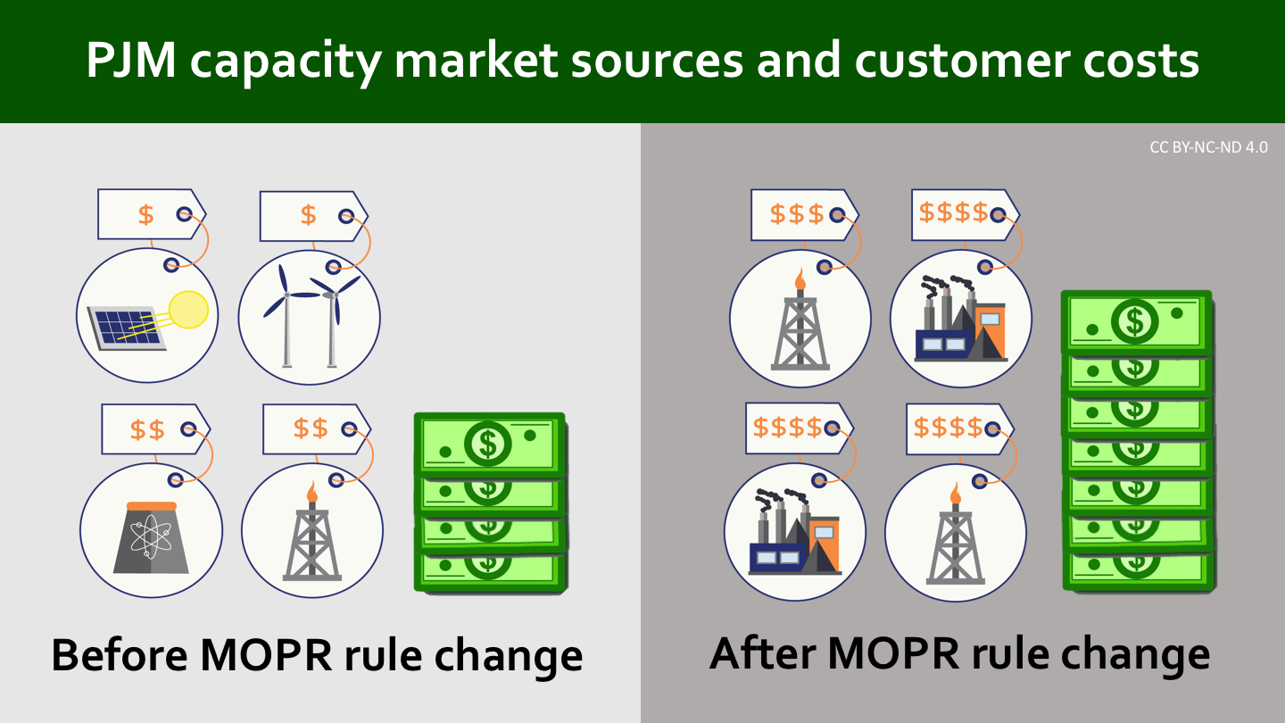
And, it could get worse with the… MOPR!
Notes:
Unfortunately there are still more ways that the PJM capacity market is being bent to funnel money to uncompetitive fossil fuel plants. Here’s one that hasn’t happened yet, but is about to as soon as the Federal Energy Regulatory Commission hands down its ruling a PJM proposal that pertains to something called the MOPR – the Minimum Offer Price Rule. At a really high level the impact of this MOPR could end up significantly increasing capacity costs for consumers by replacing lower-cost renewables currently in the market with higher cost fossil fuels.

Slide 14
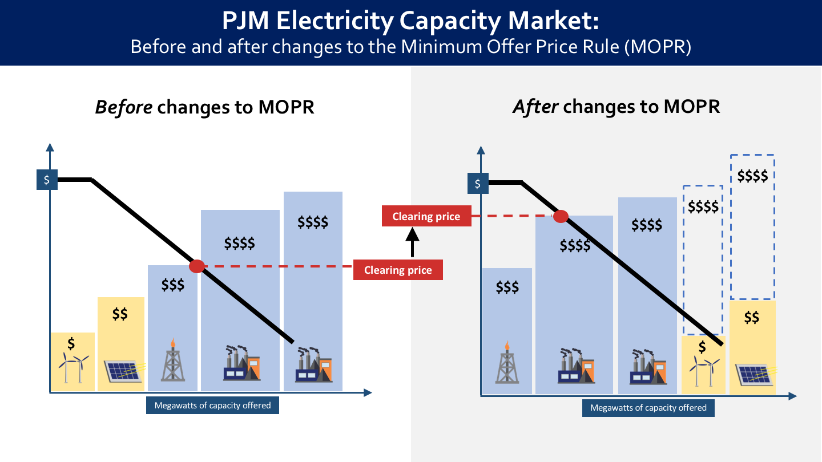
Here’s how exactly…
Notes:
Let’s take a closer look at exactly how these new rules would do this. Over on the left side we see the way the capacity market at PJM works now, with sources lined up in order from lowest cost to highest and then clearing price set at the price point where PJM’s demand line intersects with the price of capacity being offered. And remember. So on the left there we see how with lower-cost solar and wind able to bid in the clearing price is lower and the more expensive sources are cut out.
Now why are those renewable energy sources able to offer their capacity at low cost? Well, in some cases it’s because they incentivized or supported by states for their ability to meet energy needs without creating pollution costs, such as through renewable portfolio standards. So fossil fuel plant owners complained that was unfair and what PJM and FERC are poised to do is shown over on the right – which is to make those sources that are being prioritized by states pretend like they don’t have that support and offer at artificially high prices in the capacity market. The end result, as we see in the graphic on the right, is that these clean energy sources that consumers are already supporting for their ability to avoid pollution costs end up excluded from the capacity market, the clearing price is higher and the costs of the market go up and let fossil fuel plants that would have been excluded get paid.
So do the gas and coal plant owners have a valid point that it’s unfair that they have to compete with sources like solar or wind or nuclear that get state support through local policies? They don’t. The fact is that polluting sources are also receiving state support – in the form of all the costs of their pollution on health, climate, water and air that are ultimately paid by local governments and residents.

Slide 15



We need a really good regional grid and markets
to make a clean, no-fossils future possible & economical
Notes:
Ok, no now we’ve seen some of the reasons why PJM’s market is lagging nationally compared to other RTOs – with its capacity market that is essentially slowing the pace of clean energy transition by funneling money to uncompetitive gas and coal plants – and with an upcoming additional change that could do even more of that while undercutting state clean energy standards and goals. So does this mean we should throw PJM out the door? Not really, no. The fact is that to get to a day where we can truly have a clean grid without fossil fuels, we do need a regional grid and markets to make it possible and economical. We’re going to need to smoothly be able to send wind and solar power from one state to another to make best and most economical use of available land and renewable resources and to accommodate for variability in conditions. We’re going to need to be able to integrate in battery storage and flexible building sector loads in our building and transportation sectors to flex and match up demand with a grid driven by renewables.

Slide 16
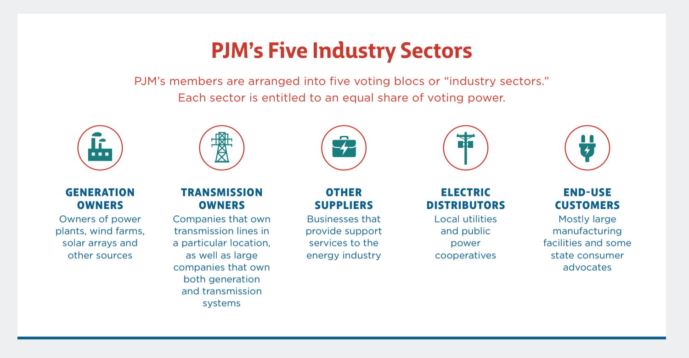
PJM members… but states hold tons of sway
Notes:
States carry a lot of sway. It can start with voicing concern over the MOPR or over other aspects of the capacity market we discussed today that are costing consumers and stifling the pace of clean energy development. And then it can go further to some of these other aspects like storage and demand response too. Little by little we can get there.

Slide 17
