Slide 1
FOOD WASTE PREVENTION AND SAFE FOOD DONATIONS
IN FOOD FACILITIES
A training guide for health inspectors
Notes:
Talking Points: Hi, I am INDIVIDUAL INTRODUCTION. I’m glad that you are joining us today for this training about the role that health inspectors play in wasted food prevention in businesses and opportunities for securing safe food donation.
This presentation was developed by the Natural Resources Defense Council (NRDC) as part of their Food Matters Initiative. The Food Matters Initiative works to reduce food waste in cities through innovative solutions and strategies.

Slide 2
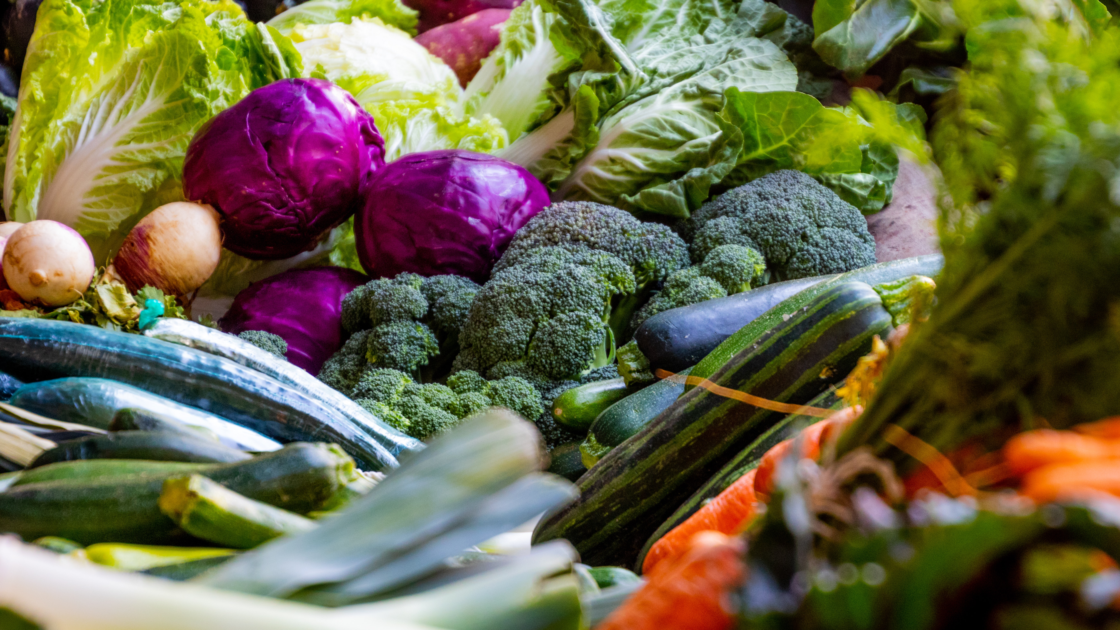
THE SCOPE OF FOOD WASTE
WASTED FOOD PREVENTION
SAFE FOOD DONATION
OUTREACH MATERIALS
Notes:
Presenter Notes: The outreach materials and tracking section should be updated based on whether your department has already created these materials, or they are in progress. If you will not have your health inspectors distribute information during inspections, the section can be deleted from the presentation. Please see the tool on our website for more information about these materials.
Talking Points: In today’s training we will:
Discuss the scope of food waste in the United States and in consumer facing businesses
Look at where food facilities might prevent food from being wasted through education about cost savings and food safety
Discuss why donation of surplus food to people in need is so important
And talk about the outreach materials and tracking suggestions for your inspections

Slide 3

WHY HEALTH INSPECTORS?
Regular interaction with food facilities leading to partnership by educating about cost savings and donation opportunities
Convey city’s interest in sustainability goals, preventing food waste and rescuing surplus food to feed food-insecure community members
Equip food facilities with resources for safe food donation and provide employee education to reduce food waste and save money
Notes:
Talking Points: I’d like to start this presentation by providing a brief explanation as to why health inspectors have a vital role to play in addressing food waste and securing safe food donations. Wasted food is an enormous environmental problem in the United States and when good food goes uneaten, it is also a lost opportunity to redirect that food to make sure that it is consumed by people. Given your deep knowledge of food safety issues, regular interaction with food businesses, and your role as regulators, inspectors have a unique and important part to play in preventing wasted food and food donation while ensuring that the food remains safe. By engaging on this issue, you, as health inspectors can: (1) educate restaurants about how they can reduce food waste and save money by practicing better food safety, (2) convey the city/county’s interest in preventing food waste, rescuing surplus food to feed food-insecure community members, and sustainability goals and (3) help food facilities to better understand what/how/when/where food can be donated legally and break down perceived burdens or myths to businesses to facilitate these donations.

Slide 4
THE SCOPE OF FOOD WASTE
Notes:
Talking Points: With that context in mind, let’s dive into discussing the scope of food waste in the United States. Why should we be prioritizing efforts to address food waste?

Slide 5
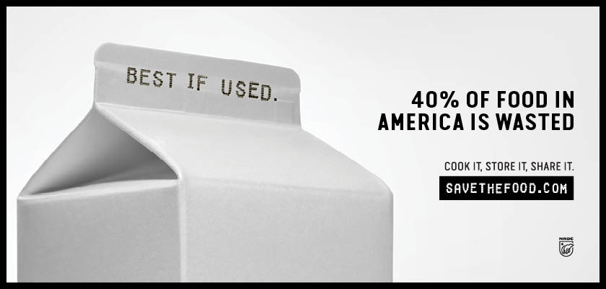
Insert best if used Save the Food ad with Milk
Notes:
Talking Points: In the U.S., up to 40% of food goes uneaten. That’s an enormous amount of food that is thrown out in our homes, in restaurants, in grocery stores and other settings every day of the year. In fact, that much food would be enough to feed 164 million people their full diet every day of the year.

Slide 6
WHERE FOOD WASTE HAPPENS
Source: A Roadmap to Reduce U.S. Food Waste by 20 Percent, ReFED, March 2016. https://www.refed.com/downloads/ReFED_Report_2016.pdf
Notes:
Talking Points: Food waste happens at every stage of our food system from farm to fork. But if you look at the blue band in this chart – the largest chunk – that is the portion of U.S. food waste that occurs in consumers’ homes, representing about 43% of all food wasted. Although it is not widely recognized, consumers at home are the largest single source of wasted food in the United States. From there, restaurants are the second largest source, at 18% of the total. Grocery stores and distribution generate another 13% and institutional food service (like colleges, hotels and stadiums) generates another 8% of the food waste produced in the U.S. Added together, foodservice businesses represent approximately another 40% of the estimated food waste generated in the US, or about equal to the amount of waste generated by households.

Slide 7
WHERE FOOD WASTE HAPPENS
As a health inspector, you probably have frequent direct interactions with these sectors
Source: A Roadmap to Reduce U.S. Food Waste by 20 Percent, ReFED, March 2016. https://www.refed.com/downloads/ReFED_Report_2016.pdf
Notes:
Talking Points: Many of these businesses and institutions are the types of facilities you visit every day and I’m sure you sometimes see perfectly wholesome food going straight into the trash. Your frequent interactions with these businesses and institutions are a key opportunity to highlight this problem and help these businesses to make changes internally to reduce food waste.

Slide 8




FOOD WASTE COSTS OF FOOD FACILITIES NATIONALLY
Consumer-facing businesses account for 40% of food waste
The US restaurant sector generates11.4 million tons of food waste annually
Which adds up to a cost of more than $25 billion annually
For every dollar invested in food waste reduction, restaurants can realize $14 cost savings
Source: Restaurant Food Waste Action Guide, ReFED, 2018. https://www.refed.com/downloads/Restaurant_Guide_Web.pdf
By the Numbers: The Business Case for Reducing Food Loss and Waste, Champions 12.3, 2017. https://champions123.org/sites/default/files/2020-08/business-case-for-reducing-food-loss-and-waste.pdf
Notes:
Talking Points: Looking specifically at consumer-facing foodservice businesses, we can see that there are major costs associated with wasting food, on top of the environmental impacts. These businesses account for about 40% of the food wasted in the US. U.S. restaurants alone generate 11.4 million tons of food waste annually, adding up to a cost of more than $25 billion. For every dollar that a restaurant invests in food waste reduction strategies, they can see up to $8 in cost savings.

Slide 9




FOOD WASTE COSTS AT FOOD FACILITIES
When a food establishment wastes food, they also waste the original cost of the food, the potential profit if sold, environmental resources, and water
Wasting 10 pounds of steak can be $73 in wholesale costs lost
That can be an average of $300 in lost profits if those steaks had been sold
Which is the equivalent of 670 passenger miles driven in GHG emissions generated from the steaks
And a loss of 18,453 gallons of water lost from growing, processing and transporting the steaks
Source: Wholesale Price Update. Beef. It’s What’s for Dinner. 2021. https://www.beefitswhatsfordinner.com/resources/wholesale-price-update
Product gallery. Water Footprint Network. https://waterfootprint.org/en/resources/interactive-tools/product-gallery/
Greenhouse gas equivalencies calculator. United States Environmental Protection Agency. 2021. https://www.epa.gov/energy/greenhouse-gas-equivalencies-calculator
Notes:
Talking Points: Food waste also has high costs for individual food facilities. When a food establishment wastes food, they also waste the original cost of the food, the potential profit if sold, the environmental resources and water use from that food. Take 10 one pound steaks that might be wasted due to safety or temperature concerns. Those steaks could be $73 in wholesale costs based on meat cost projections, an average of $300 in lost profits if those steaks had been sold at $30 per steak. That’s the equivalent of 670 passenger miles driven in GHG emissions generated from the wasted steaks and a loss of almost 18,500 gallons of water. No food facility can afford those kinds of costs!

Slide 10


WHAT ELSE IS WASTED?
up to 40%
of all food goes uneaten
21%
of US Agricultural Water Use
19%
of Cropland
18%
of Fertilizer
22%
of Landfill Content
37m
Cars-worth of GHGs
Source: NRDC, Wasted: How America Is Losing up to 40 Percent of it's Food from Farm to Fork to Landfill, 2017; Photo: 2 iStock, Urs Siedentop/iStock
Notes:
Talking Points: When people and businesses waste food, they are also wasting all of the resources that went into producing that food. The food we waste represents 21% of the water used in U.S. agriculture. Food waste in the US also accounts for nearly 20% of cropland and fertilizer use. Wasted food is the single largest item going into our landfills. And wasting food generates greenhouse gas emissions every step of the way, from production, processing, packaging, shipping, preparation and disposal. The greenhouse gas emissions generated by wasted food are equivalent to the GHG output of 37 million cars, or one in thirteen cars on the road today.

Slide 11
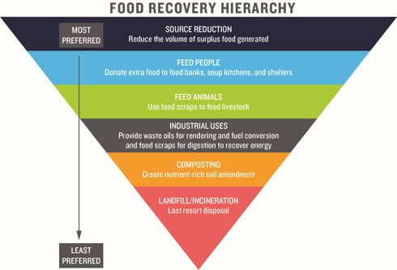
MANAGING FOOD WASTE REDUCTION
  This presentation includes strategies related to Source Reduction and Feed Hungry People
Source: Food Recovery Hierarchy, EPA, 2019. https://www.epa.gov/sustainable-management-food/food-recovery-hierarchy
Notes:
Talking Points: The Environmental Protection Agency created a helpful graphic for understanding the hierarchy of addressing food waste. The greatest environmental and social benefits associated with food waste are in preventing food from being wasted in the first place. For businesses, this can mean ensuring that all food purchased is consumed, through strategies such as cooking with all parts of food, practicing better food safety protocols to avoid the need for disposal, and evaluating surpluses in inventory. If, after maximizing food waste prevention, businesses still have surplus food, it’s important to donate suitable food for redistribution to people in need. Finally, any inedible parts or food that cannot be eaten should be recycled through composting, anaerobic digestion, or animal feed. The top two approaches to food waste reduction, prevention and donation, are the ones that we will be focusing on during this training.

Slide 12
PREVENTING WASTED FOOD FOR BUSINESSES
Notes:
Talking Points: Now that I’ve laid out the general scope of food waste in the United States, let’s discuss the overlap between preventing wasted food, cost savings and food safety. By making the case that food facilities can see cost savings by implementing food waste reduction strategies, food facilities can use these strategies to improve food safety practices.

Slide 13


MESSAGES AND TOOLS FOR WASTED FOOD PREVENTION
Messages around COST SAVINGS generally resonate with food establishments
Here’s what you can say:
“By reducing food waste, you can save money”
“Practicing better food safety also reduces food waste and ensures you can serve all your food”
“There are also beneficial impacts on your community and the environment”
Consider taking temperature logs
to ensure food is not spoiling and stays at peak quality longer
Here are some ideas for food facilities to use:
Make sure you are doing
quarterly maintenance
on all cooling appliances to ensure proper functioning
Notes:
Talking Points: For businesses, when food waste is prevented, financial benefits are maximized because purchased food is fully consumed and used. You all can play an important role in preventing food from going to waste in food facilities. Messages around cost savings generally resonate with food facilities that have very slim profit margins. In a 2017 study by World Resources Institute and WRAP, researchers found that after evaluating cost and benefit data from 1200 businesses across 17 countries nearly every single company had a positive return from investments in curbing food loss and waste in their operations.^{i} When communicating with food facilities, you can reinforce the message that investments in food waste reduction—and food safety—almost always see a positive return. Some ways to incorporate this messaging into your communications are listed on in this slide. You can say:
“By reducing food waste, you can save money”
“Practicing better food safety also reduces food waste and ensures that you can sell/serve all of your food.”
“There are also beneficial impacts on your community and the environment”
Some helpful food safety and food waste reduction tools that food facilities might be interested in trying to save money including temperature logs and quarterly maintenance report.
Source:
^{i} Goodwin, Liz. By the Numbers: The Business Case for Reducing Food Loss and Waste. March 6, 2017. https://www.wri.org/insights/numbers-business-case-reducing-food-loss-and-waste

Slide 14








IDEAS FOR FOOD WASTE REDUCTION
Create clear directions on any storage (fridge, freezer, pantry) for all staff to follow.
Think about portion sizes when storing food. Consider shallow containers and separate food into smaller containers for storage.
Keep inventory and do not purchase foods that are not used, stored well, or reach the end of their life before use.
Track and maintain temperature logs so that all foods are accounted for and in safe range.
Assign staff to look through pantry, fridge, freezer twice per week and create menu items for foods that need to be used.
Purchase ice baths or other cooling equipment and make sure that all staff are trained in effectively using the equipment.
Keep several thermometers on site to frequently measure food temperatures.
Designate staff as on-site food safety managers to ensure that all staff are following food waste reduction and food safety protocols.
Notes:
Presenter Notes: Please update these recommendations so that they are relevant to what a health inspector might recommend at their inspections. It’s okay to get creative!
Talking Points: There are many strategies that food facilities can take to reduce food waste. This slide includes a few recommendations. These include keeping a better inventory of food in storage, updating signage, suggesting different container sizes, better maintenance records, or assigning staff to be a point person for collecting food that is close to end of life. These recommendations are really up to you, and are could be similar to what you already tell facilities. This is a great opportunity in your inspections to think about discussing some of the environmental and financial impacts of letting food become unsafe and go to waste.

Slide 15

WHAT ARE YOU SEEING IN YOUR COMMUNITY?
What are some of the most common reasons food establishments throw out good food?
What message resonates most with food facilities (cost savings, environment, etc.)
Are there opportunities for you to provide education about food waste during your inspections?
Notes:
Talking Points: The recommendations presented are just some theoretical examples. Every community is different and this is where you are going to be most helpful. What are you seeing in the food facilities that you visit? What violations or scenarios do you see that most often lead to food waste? What recommendations like these have you used or will use to incorporate food waste talking points into inspections? Do you think that this is a viable or worthwhile approach?
Allow for ~5 minute audience discussion at this point
Audience Discussion (2-5 min): Ask the audience what are you seeing in the food facilities that you visit relevant to food waste? What violations or scenarios do you see that most often lead to food waste? What recommendations like these have you used or will you use to incorporate food waste talking points into inspections? Do you think that this is a viable or worthwhile approach?

Slide 16
SAFE FOOD DONATION
Notes:
Talking Points: Next we are going to discuss safe food donation. All communities have residents who lack the means to consistently obtain the foods they need. Food insecurity is a pervasive challenge in the U.S., with nearly one in eight Americans needing assistance to meet their food needs. The donation of surplus food by grocery stores, restaurants, hotels, colleges, schools, sports facilities, food manufacturers and other licensed food facilities is an important strategy for reducing the amount of food that is discarded and closing the meals gap in our communities. While food donation doesn’t solve the root causes of why people are not able to afford enough food, it is critical for channeling appropriate foods to people in need. In this section we will discuss food insecurity, why food donations are important, common myths that deter food facilities from donating food, and facts for food facilities interested in donating food.

Slide 17
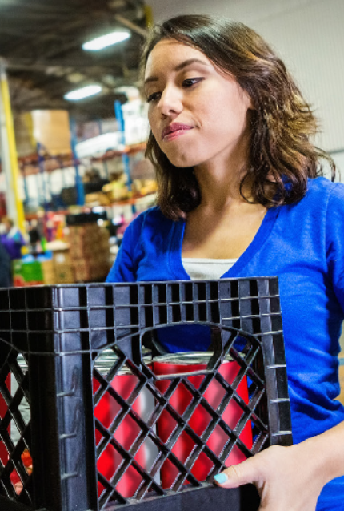
FOOD INSECURITY IN [YOUR CITY]
1 in X people in [Your City] are food insecure
That is X% of the population
Compared to 10.5% nationally (2020)
[YOUR CITY] meal gap = [x] million meals per year
National meal gap = 6.3 billion meals per year (2018)
Notes:
Presenter Notes: You will need to fill in these numbers based on your community. It is also a good idea to update the national average food insecurity number which you can find here: https://www.ers.usda.gov/topics/food-nutrition-assistance/food-security-in-the-us/key-statistics-graphics.aspx
Talking Points: The USDA defines “food insecurity” as the lack of access, at times, to enough food for all household members. Here we focus on some of the statistics for CITY/COUNTY NAME. Roughly 1 in XX residents are considered food insecure. That’s X% of your community’s population relative to a national average of XX (10.5% as of September 2020). When you convert the food budget shortfall in a specific area into a number of meals that that shortfall represents, you get what’s called the meals gap. In CITY/COUNTY NAME, the meal gap is estimated at XX million meals per year. Nationally, the meals gap is 6.8 million meals per year. Expanding donation of surplus foods from grocery stores, restaurants, institutions and other sources -- and making sure it’s done safely -- can be a key part of the solution to fill this meals gap.
PRE-TRAINING WORK:
Instructions for calculating the meals gap in your community:
The information needed for this slide can be obtained from the Food Insecurity in America map at Feeding America’s website: https://map.feedingamerica.org/. Feeding America has estimated food insecurity rates for every county in the U.S. As information is available for counties and not for cities, you may need to present your data in the powerpoint for your county or identify an alternate source of data. We suggest calculating the figures shown on slide 15 as follows:
To calculate food insecurity rates: In the Feeding America map of the U.S., hover over your county to see the data for your county. Use the figure shown for the number of food insecure people and divide it by the population of your county.
For national food insecurity rates, scroll down below the U.S. map to find the estimated number of food insecure people in the U.S. (This figure was 40.4 million as of September 2019). Divide that figure by the total U.S. population to arrive at the percentage of Americans who are food insecure. (This figure was 10.5% as of 2019, reported in September 2020)
To calculate the “meal gap” in your county, use the Feeding America data for your county. Divide the “Additional Money Required to Meet Food Needs” figure by the “Average Meal Cost” for your county. The meal gap is an estimate of the amount of money that county residents lack to purchase the food needed to meet their needs. That financial shortfall is then translated into the number of meals using the average cost per meal for a given county. Feeding America provides more information about how Meal Gap data was determined here.

Slide 18
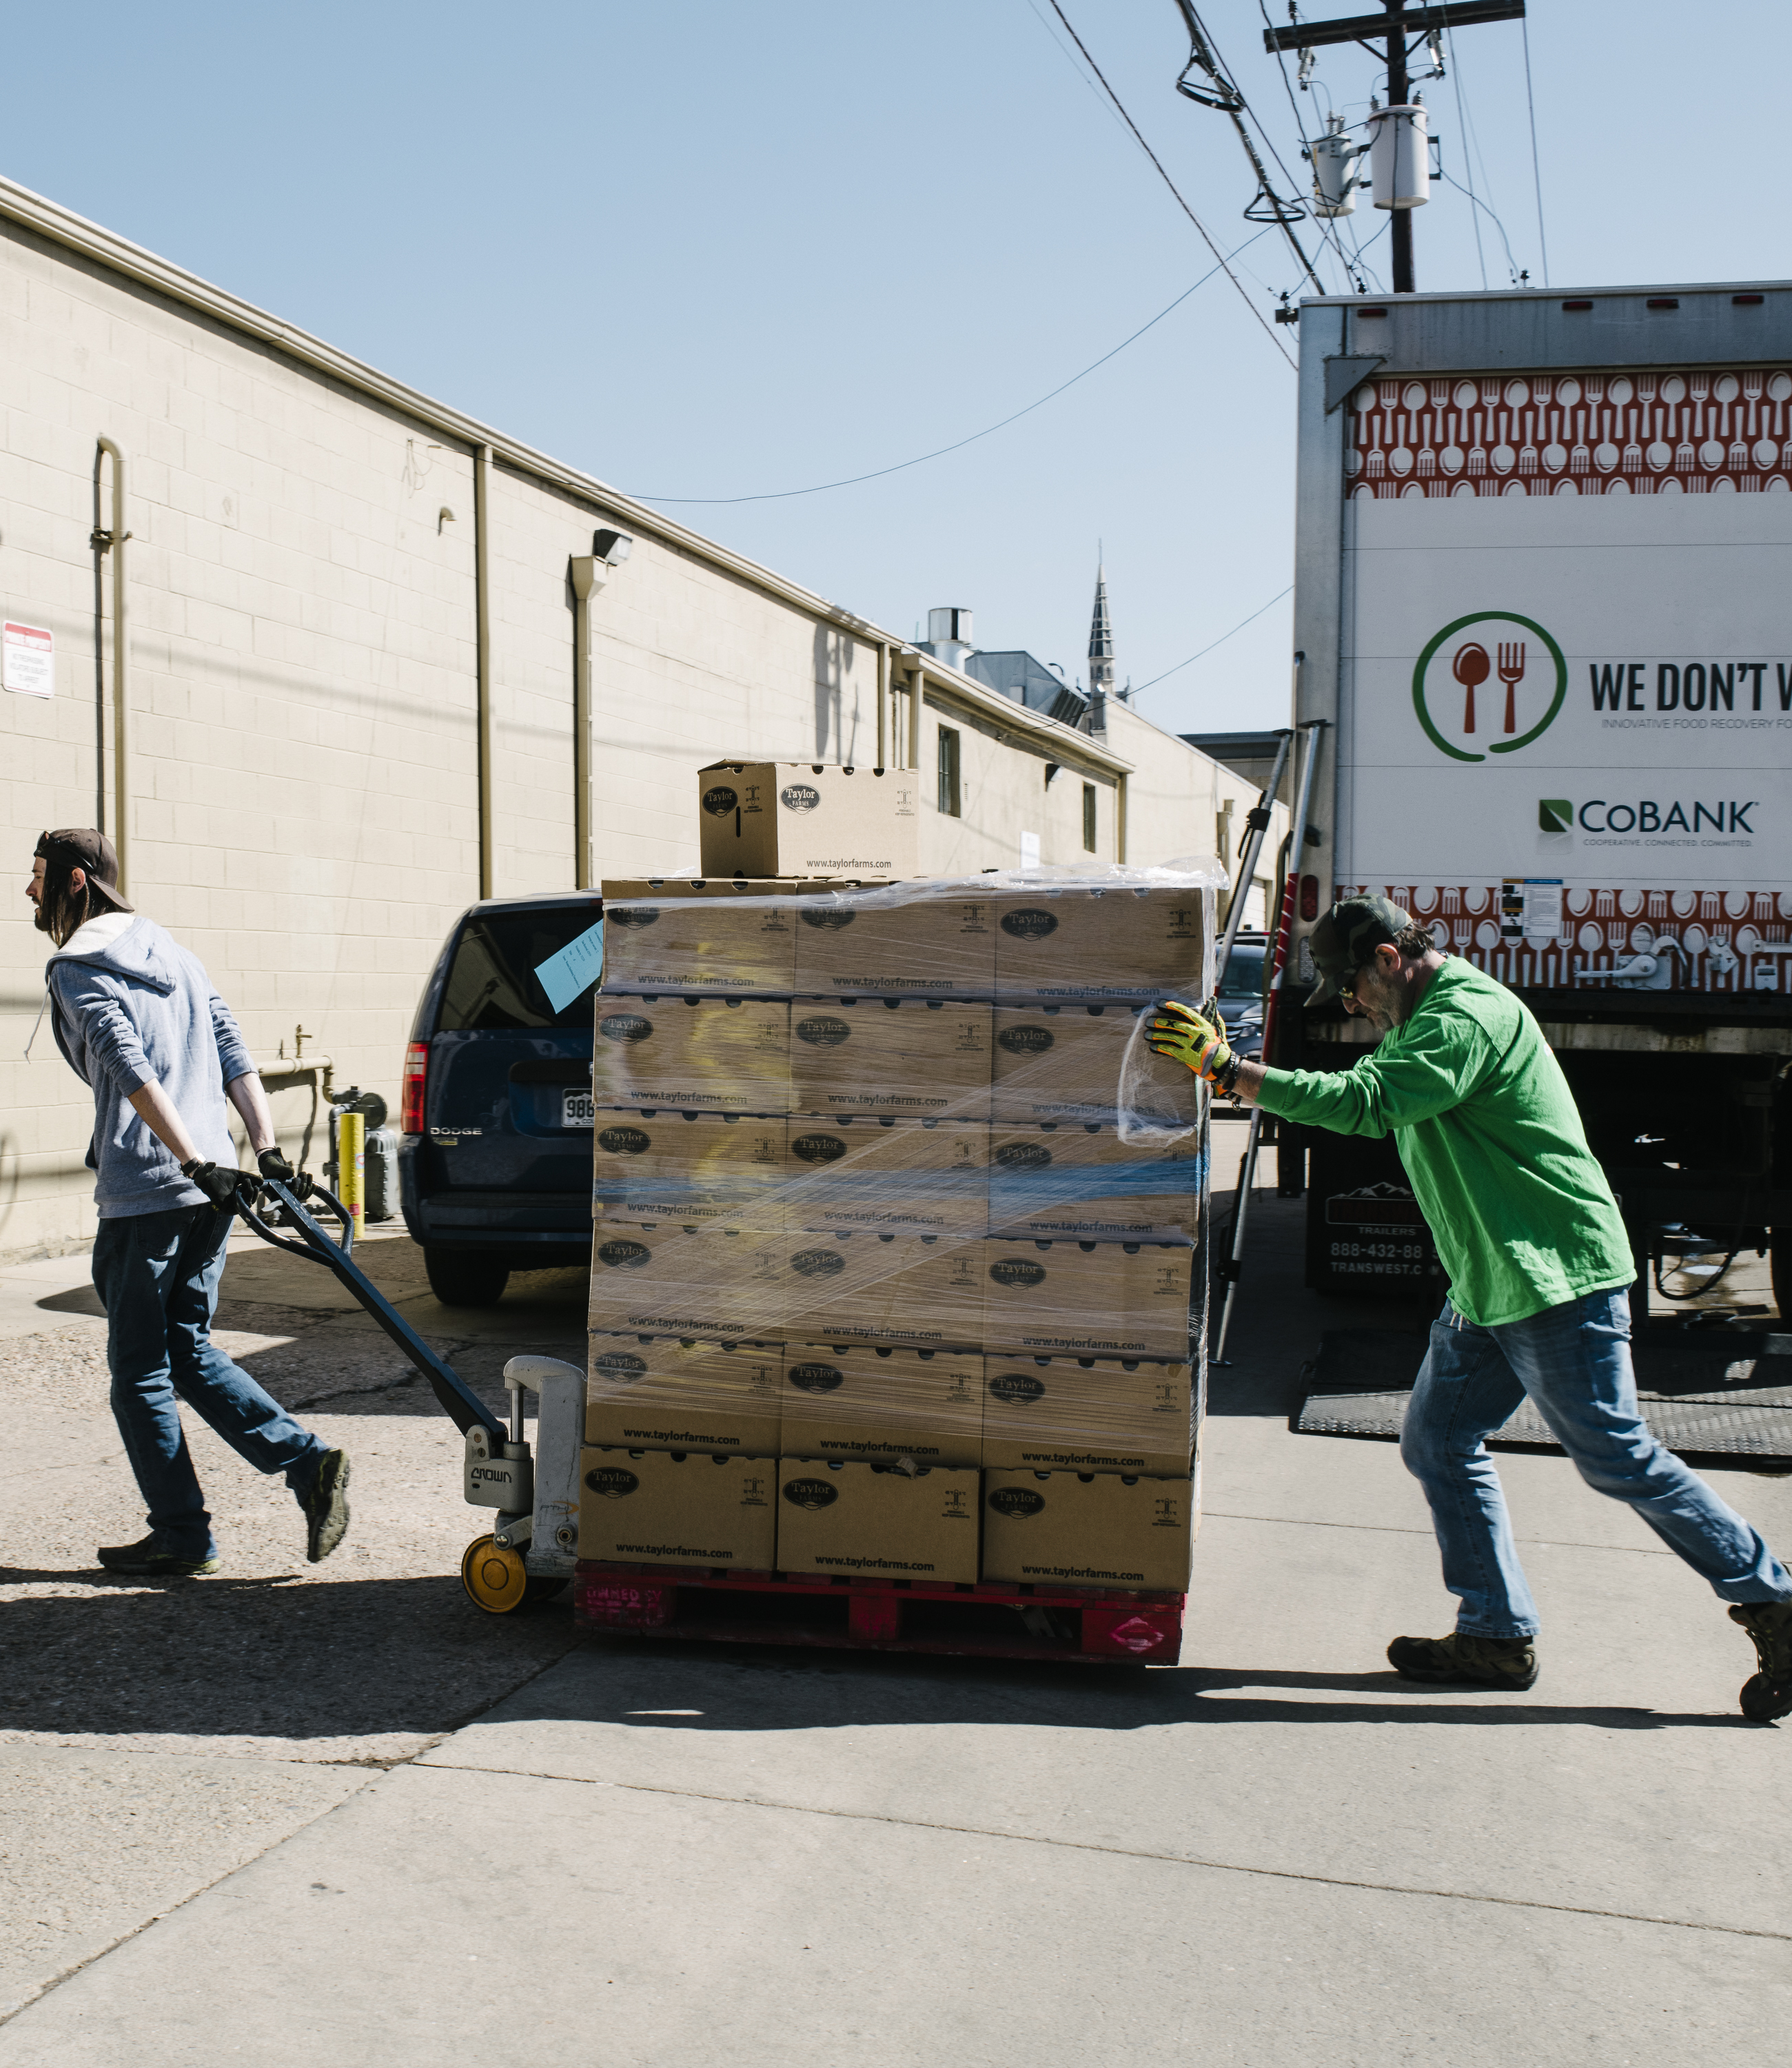
THE LINK BETWEEN WASTING FOOD AND FOOD RESCUE
Food rescue is not a solution to hunger, which stems from complex problems like income and access.
Expanding safe donation of surplus food can be part of the near-term solution
Safe, healthy surplus food can be found across almost all city sectors
In one study, three cities that maximized food rescue could see up to 48% of their meal gaps filled
Notes:
Talking Points: Food insecurity stems from several complex systemic problems including lack of sufficient income, transportation, housing and childcare. Emergency food assistance, such as food donation, is not a systemic solution to hunger. It is, however, critical for channeling appropriate and safe food to people who need it. Often, this perfectly good donated food would otherwise go to waste. Increasing safe food donations across city sectors can be a part of the solution to reduce the amount of food ending up in our landfills. One study by the Natural Resources Defense Council found that if cities like Denver and Nashville fully maximized food donation from the food businesses in their communities, they could theoretically meet almost 50% more of their cities’ meal gap, beyond the amount of food being donated right now. Expanding food donation can really make a difference to helping address immediate community needs.

Slide 19


GROWTH AREAS IN SPECIFIC TYPES OF FOOD FACILITIES
Institutions: Potential for prepared food (e.g. entrees and side dishes)
Restaurants: Currently about 22% of restaurants currently donate nationally
10-35% of wasted food occurs in the back of house, which is more likely to meet safety recommendations than front of house food
Grocery Stores: Potential to secure additional donations includes fruits and vegetables, dairy, frozen meat, and deli
Notes:
Talking Points: With this in mind, it’s important to understand the unique considerations related to food donation in each kind of facility that you as a health inspector might visit. Based on the NRDC study, there is opportunity for growth in areas like prepared foods from hotels, colleges, event centers and restaurants, and an increased amount of perishable foods being donated by grocery stores. These foods are critical because they are often healthier and fresher, and an integral part of a healthy diet. But, since they are prepared, they can also pose additional food safety challenges. Additionally, institutions--like hospitals, schools, event centers and often hospitality--have potential for more donation of prepared foods. Most restaurants, on the other hand, generally have much less potential to donate food, but the high number of restaurants and overall contribution of the sector to wasted food generation adds up and represents significant additional potential, especially considering that only about 5% of restaurants currently donate. About 10-35% of food wasted in restaurants occurs in the back of house, where food is more likely to meet the safety recommendations needed for food rescue. In grocery stores, there is a lot of potential for high-need perishable donations like fruits, vegetables, dairy, frozen meat and deli. It’s helpful to know from grocery stores if they have a food rescue pick-up partner and note the frequency and departments that food is getting donated from.

Slide 20
MYTHS AND BARRIERS THAT DETER DONATION
“We will lose money because it takes up too much staff time”
“We don’t trust the health department”
“The city won’t let us donate food”
“We’re not sure what the rules are”
“It’s against business policy”
“We’re liable if something goes wrong”
“We would have to transport the food ourselves”
Notes:
Talking Points: There are many myths that can deter businesses and institutions from donating surplus food. Health inspectors might hear businesses say that the city won’t let them donate food or that they will be fined if they do so. In other cases, the business may believe that they will be held liable if something goes wrong or that they would have to deliver the food themselves. Similarly, individual restaurants or chains might have confusing messages regarding food donation, like that they don’t allow donations or discourage them. Often businesses just do not know what the rules for donation are or don’t believe that they have time or space for processing donations.
Given your deep understanding of food safety issues and role as regulators, you can make a huge difference in allaying potential food donors’ concerns. As city government employees, you can also help convey that the city government recognizes that all too many residents don’t know where their next meal is coming from and that the city actually supports the safe donation of appropriate foods. And lastly, you can communicate how to donate safely so that donors stay in compliance with applicable regulations. That’s good for food donors, food rescuers and food recipients.

Slide 21
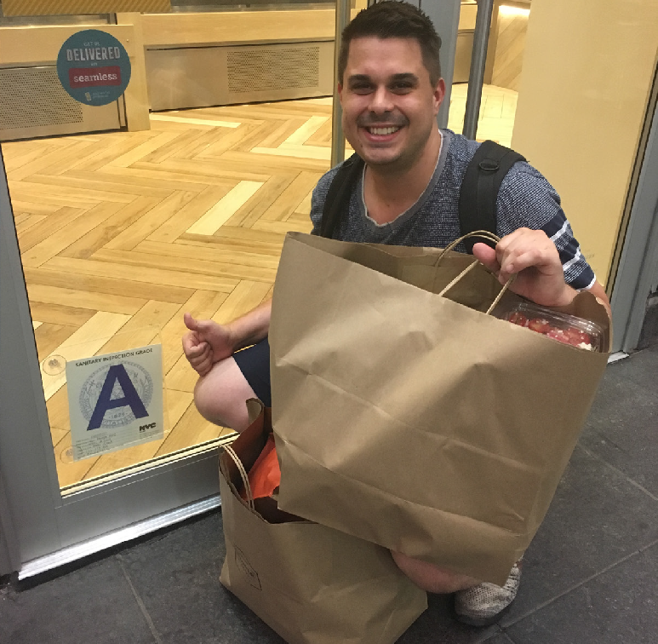

LIABILITY PROTECTIONS
Do ALL of your food establishments know that they are protected from liability?
Organizations that donate food are protected by the Bill Emerson Good Samaritan Food Act, which was passed into federal law in 1996. Organizations that donate food in good faith to a nonprofit organization for distribution to people in need are not subject to civil or criminal liability that may arise from the condition of the food.
Notes:
Talking Points: One major misunderstanding amongst food facilities is around liability protections. Often, food facilities believe that they will be sued and held liable if there are any safety issues with the food that they have donated. In fact, according to a 2016 survey by the Food Waste Reduction Alliance, 44% of manufacturers, 41% of restaurants and 25% of retailers identified liability concerns as a barrier to donation. However, as a health inspector you can inform them that the federal Good Samaritan Food Donation Act protects them against liability if they donate food in food conscience. The Bill Emerson Good Samaritan Food Donation Act was passed into federal law in 1996 and stipulates that donations of food in good faith to a non-profit organization for distribution to people in need are not subject to civil or criminal liability that may arise from the condition of the food. Several states and municipalities have even stronger liability protections to encourage the safe donation of food from food facilities. This is a really important Act that, if more food facilities knew about, could increase food donations and break down misconceptions. The key here is that it is important that ALL food facilities know that they are protected from liability if they donate food to a non-profit, but that they should practice the same safe food handling for processing donations as they do for all other foods.

Slide 22
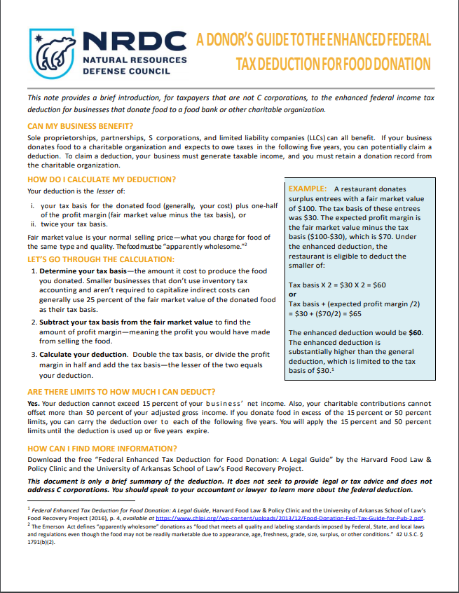

TAX SAVINGS
Do ALL of your food establishments know that they can get tax savings if they donate food?
According to the Federal Tax Code, eligible businesses can deduct the lesser of either (a) twice the cost of acquiring the donated food or (b) the cost of acquiring the donated food plus half the food’s expected profit margin if it were sold at fair market value.
Notes:
Talking Points: Food facilities should also know that there are federal tax incentives associated with donating food. Eligible businesses can deduct the lesser of either twice the cost of acquiring the donated food or the cost of acquiring the donated food plus half the food’s expected profit margin if it were sold at fair market value. In a simple example, if a restaurant donates surplus entrees with a fair market value of $100, their enhanced deduction would be $60. You should tell food facilities to talk to their tax professionals to see if they are eligible for these tax incentives when donating food. Make sure that all of your food facilities know that there are financial benefits to donating food.

Slide 23


THE TRADITIONAL FOOD DONATION CHAIN
DONORS
Do ALL of your food establishments know about local food rescue orgs that they can partner with to take donations?
FOOD RESCUE
ORGANIZATIONS/APPS
And do they know that many orgs do direct pick-ups from food establishments?
FOOD BANKS
“LAST MILE ORGANIZATIONS”
pantries, shelters, mobile
INDIVIDUALS
Notes:
Talking Points: Sometimes food facilities interested in donations might be deterred because they are concerned that they will have to transport donations themselves or they are not connected with a food rescue partner. We’ve included information on food rescue partners in the brochure that we’ve created, which should help with connecting food facilities directly with a partner that might be able to come pick up their food. Let’s briefly discuss how donated food moves from point A to point B. It starts at the food donor level, with facilities like grocery stores, restaurants, hotels, or colleges that might be able to donate unsold grocery items or unserved food from catered events or cafeterias. Donated food is typically picked up by a food bank or another organization that rescues donated food. In many cities, there are smaller non-profits, start-up companies, or apps that facilitate the pickup and delivery of donated food. Food is then delivered to a “last mile organization” like a food pantry or a homeless shelter, which provides it to people in need. This process is the traditional approach—across the country there are many community organizations and food systems groups that are working to more systemically approach hunger and food insecurity in their communities. Inform your food facilities that they can probably find a food rescue partner who is willing to pick up donations directly from the facility.

Slide 24
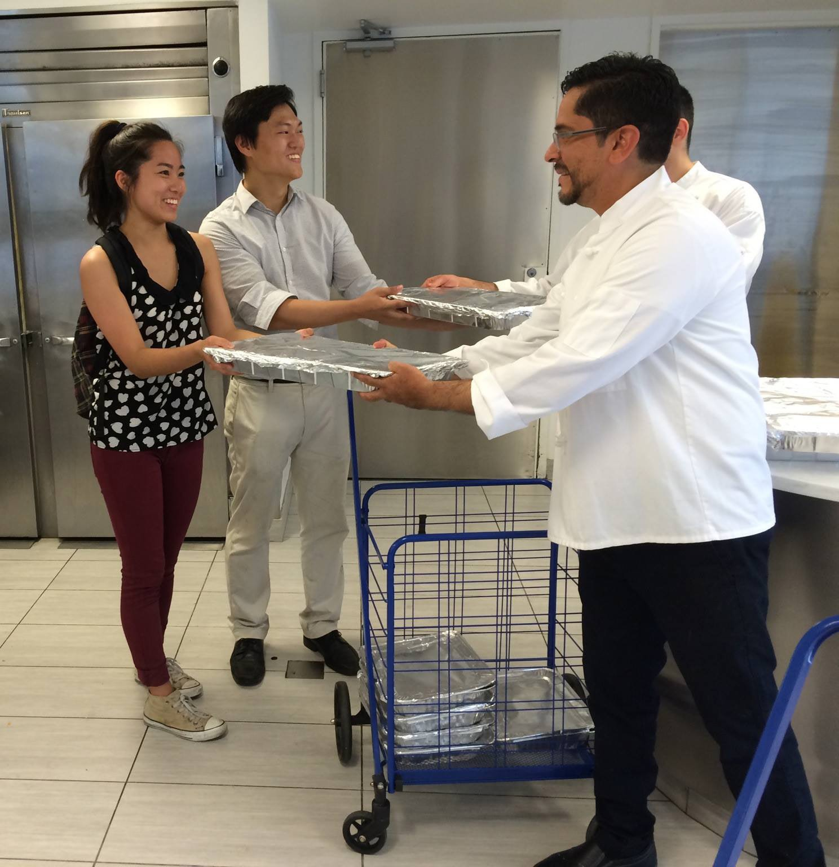
HOW TO DONATE FOOD SAFELY
Do ALL of your food establishments know how to properly process food donations?
Donors should adhere to city/county food safety rules and regulations for all donations
Donations should be labeled “Donated Food - Not for Resale”
Donors should take all reasonable steps to maintain integrity of the food
Temperature should consistently be monitored
Notes:
Talking Points: Most importantly, as a health inspector, you can talk through any food safety related questions or concerns that a food facility might have regarding HOW to donate food and connect with food rescue partners to make sure that donations make it to individuals that need it. In order to ensure that donated food is kept safe, donating facilities should adhere to all applicable sections of city/county food code. Make sure that donors know that they should label all foods as “Donated Food- Not for Resale.” Licensed food facilities should take all reasonable and necessary steps to maintain the integrity of the product that is being donated. If the food is unable to be delivered at proper temperatures, is adulterated, or is compromised at any time, then the food must be composted or discarded. Similar to foods that will be served, the best way to ensure that safe temperature requirements are being met is to monitor the temperature of the food. The safety of the food is the responsibility of not only the donor, but also the deliverer and the recipient of the food. Donors should ensure, to the best of their ability, that the food being donated is as safe as possible.

Slide 25
FOODS THAT CAN/CANNOT BE DONATED
FOODS THAT CAN BE DONATED:
HOT FOOD that was not served to a guest or placed on a buffet and kept at proper temperatures and/or cooled properly (entrees, soups, etc.)
COLD FOOD that was not served to a guest and kept at proper temperature (sandwiches, yogurt parfaits, salads, etc.)
PRODUCE (strawberries, cut leafy greens, onions, tomatoes, herbs, etc.)
BEVERAGES (juice, bottled water, lemonade, tea, etc.)
PACKAGED ITEMS (dry pasta, canned vegetables, etc.)
DAIRY PRODUCTS that have been kept at proper temperature (sour cream, milk, yogurt, cheese, etc.)
RAW MEAT that have been kept at proper temperature (beef, chicken, pork, etc.)
FOODS THAT CANNOT BE DONATED:
Previously served food such as a buffet or that has been served to a guest and returned to the business
Distressed foods (that have been in a flood, fire, smoke, etc.)
Food in sharply dented or rusty cans
Food in opened or torn containers exposing the food to potential contamination
Reduced oxygen packaged foods prepared in house (vacuum packaged or sous vide)
Notes:
Presenter Notes: Double check the foods that can/cannot be donated to ensure that they align with your city/county food code.
Talking Points: This slide shows foods that can and cannot be donated. Licensed food establishments can donate food that has not been served, including any raw, cooked, processed, packaged or prepared food, ice, beverage, or ingredient used or intended for use, in whole or in part for human consumption, with the condition that the items be wholesome (meaning, varied diet). Generally, high priority foods for food rescue organizations or other anti-hunger groups include produce, dairy, meats and other protein.

Slide 26
OUTREACH MATERIALS AND TRACKING
Notes:
Talking Points: I’m going to spend the remainder of the time talking through some outreach materials that you can use in your upcoming interactions with food facilities.

Slide 27

OUTREACH MATERIALS
Food waste prevention handout for managers
Safe food donation tri-fold brochure
Safe food donation one-pager
Safe food donation technical guidance
Notes:
Presenter Notes: These talking points should be modified based on whether your department has already created these materials or plans to create them. You can also customize based on which materials you are using. If you are not using all of the materials, you can delete the relevant slides. Updating the talking points about distribution of outreach materials based on how your inspectors will distribute (ex. will they email after inspectors or provide printed materials in person?)
Talking Points: There are several outreach materials for public health departments to communicate about these issues with food facilities. We’ve customized these materials for CITY NAME and they are now available for you to use during inspections. Materials include a food waste prevention handout for managers, a user-friendly tri-fold brochure that gives facilities an overview of food donation issues and a one-pager with safe food donation and technical guidance with will live on the website. The technical guidance provides “a one stop shop” where facilities can find all of the regulations they need to understand to donate safely including a link to the full food code. You should pass out the printed materials during your routine health inspections and point businesses to the information on the city’s website in addition to verbally talking to food facilities about wasted food prevention strategies and opportunities for safe food donation.

Slide 28
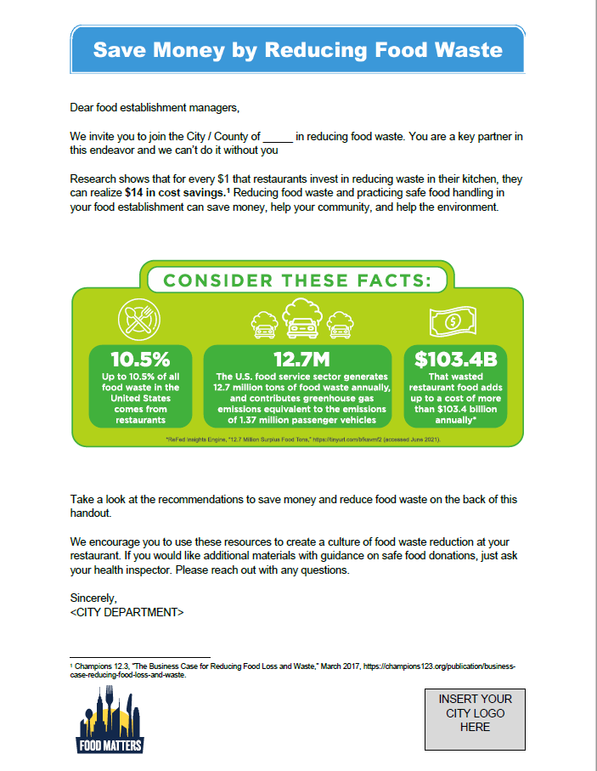
FOOD WASTE PREVENTION HANDOUT FOR MANAGERS
Outreach:
  Provide printed or emailed handout for managers at all food facilities
  Provide during food safety trainings and other public events
Guidance includes:
  Recommendations for food safety and food waste reduction
  Food waste stats
  Information on potential cost of wasting food
Notes:
Presenter Notes: These talking points should be modified based on whether your department has already created these materials or plans to create them. Food-waste related violations handout template
Talking Points: The goal of this handout is to communicate the links between food waste reduction and cost savings to food facility managers. It provides helpful information about how food facilities can reduce their food waste, food waste stats and information on the potential cost of wasting food.

Slide 29
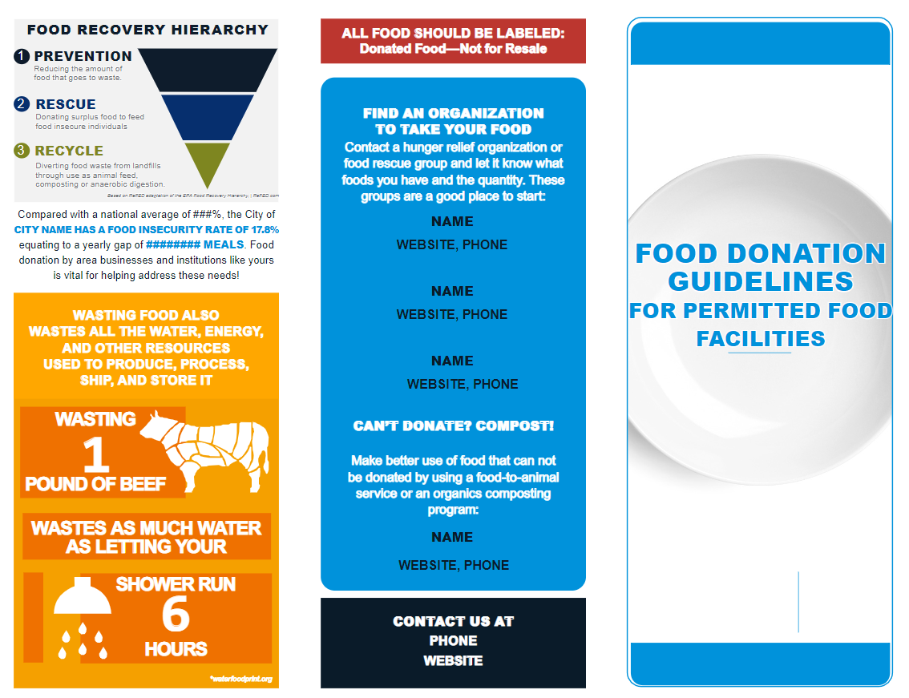
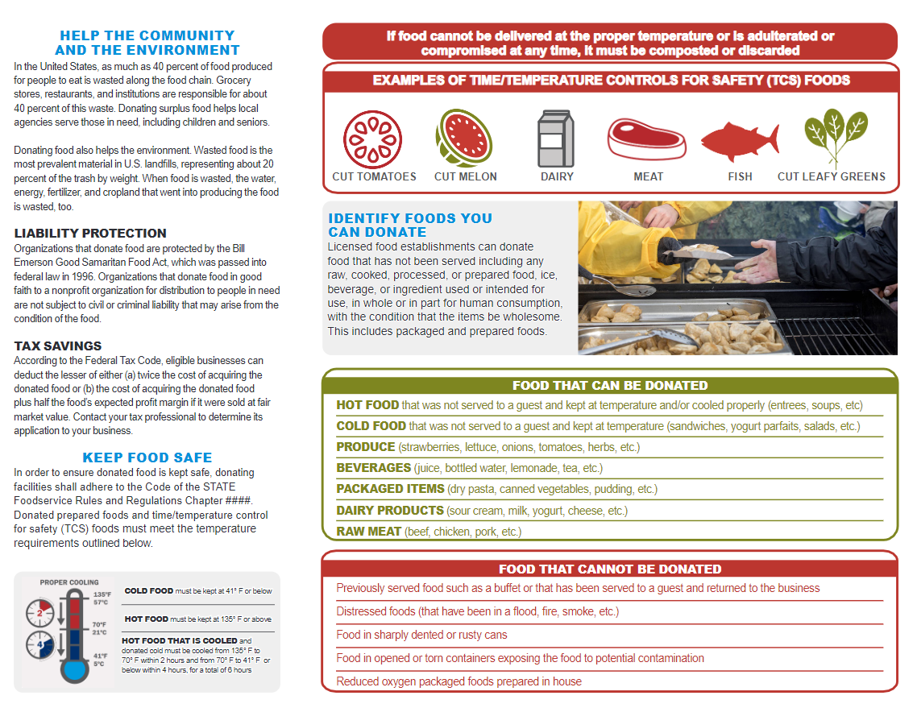
SAFE FOOD DONATION TRI-FOLD BROCHURE
Outreach:
  Provide printed or emailed brochure with other printed inspection materials at all facilities
  Provide during food safety trainings and other public events
Guidance includes:
  Overview of food waste and food insecurity
  Liability protection and tax savings information
  What kinds of foods can be donated
  How facilities can keep food safe
  Local organizations that can accept donated food
  Community food insecurity data
Notes:
Presenter Notes: These talking points should be modified based on whether your department has already created these materials or plans to create them.
Talking Points: This slide shows an example safe food donation brochure. The brochure covers local food insecurity issues, provides an overview of how to donate food safely, and shares basic information about what foods can and can’t be donated, liability issues, tax incentives, and local food rescue organizations. We ask that you start to provide a printed handout during all of your inspections and make this handout available during all food safety trainings.

Slide 30
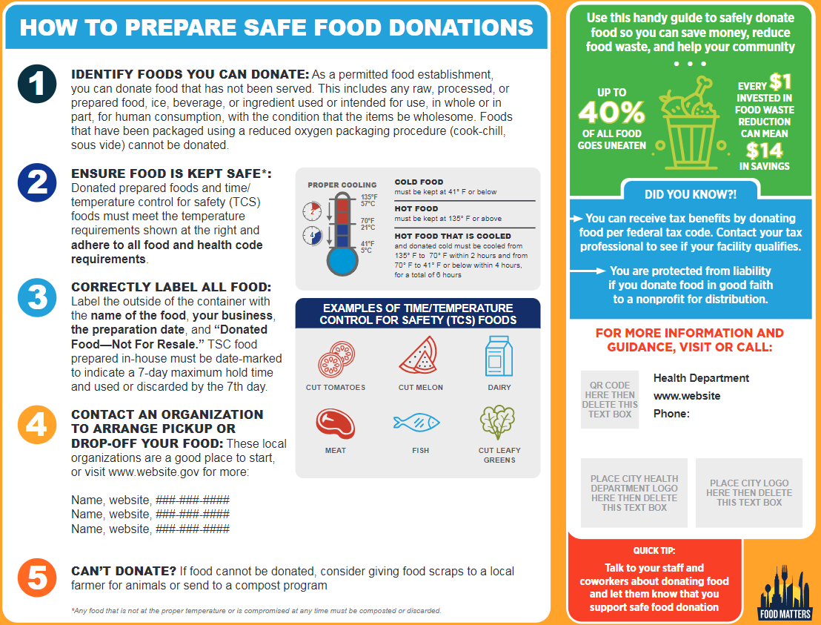
SAFE FOOD DONATION ONE-PAGER
Outreach:
  Provide printed or emailed one-pager with other printed inspection materials at all facilities
  Provide during food safety trainings and other public events
Guidance includes:
  Brief liability protection and tax savings information
  How facilities can keep food safe
  Local organizations that can accept donated food
Notes:
Presenter Notes: These talking points should be modified based on whether your department has already created these materials or plans to create them.
Talking Points: This slide shows an example safe food donation one-pager. The one-pager has less information than the brochure and is intended for quick access to kitchen staff processing donations and the food rescue partners that can collect those donations.

Slide 31
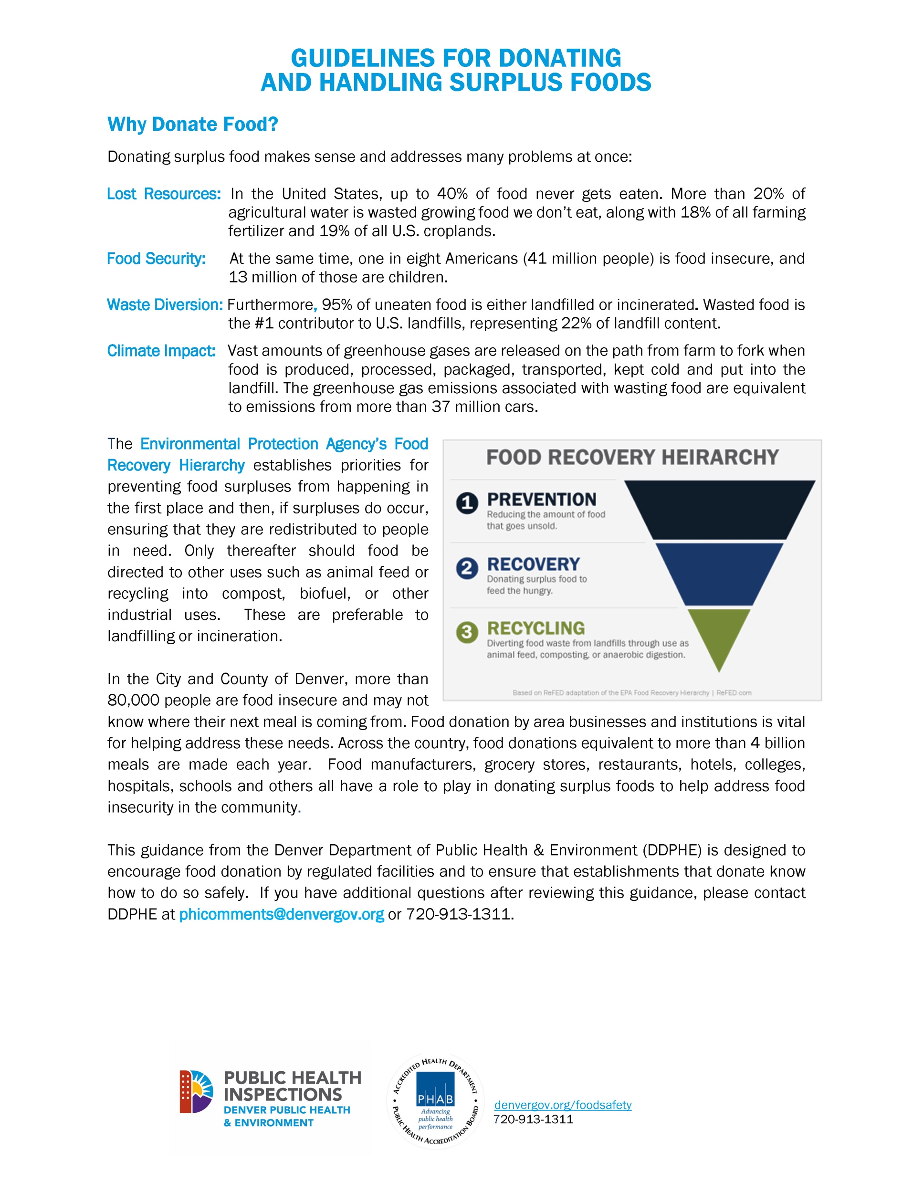
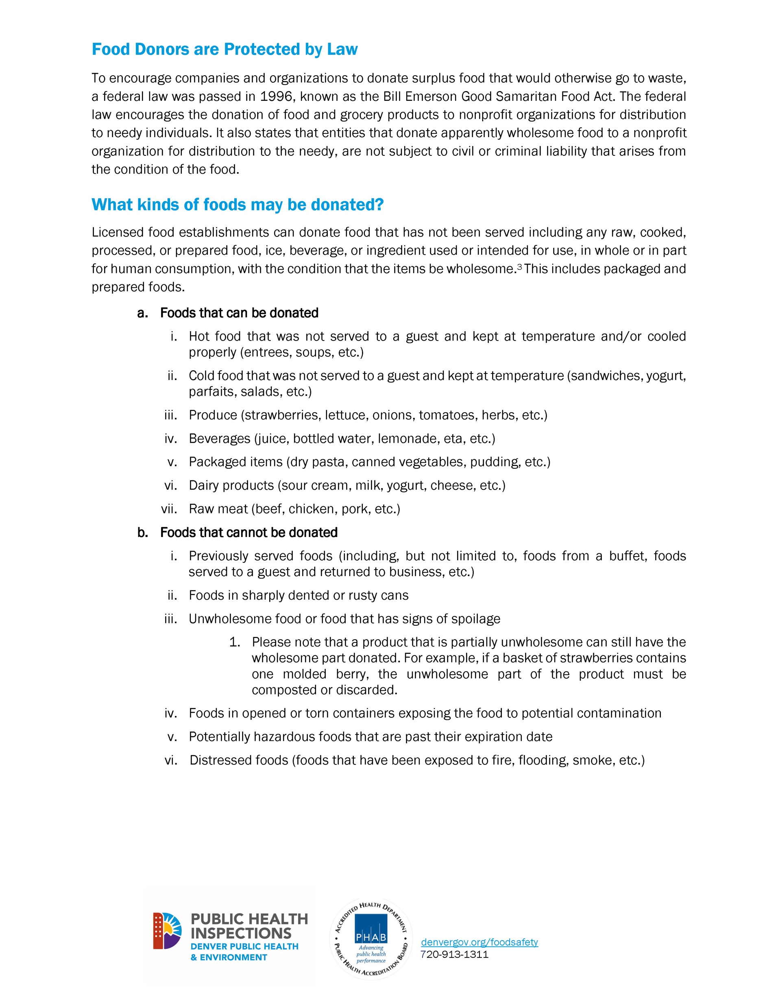
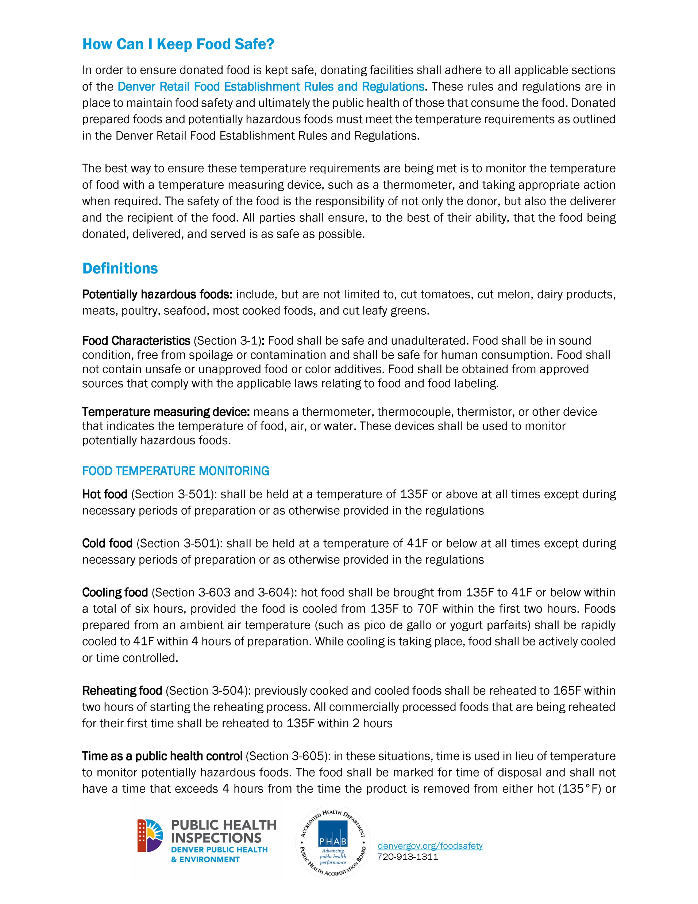
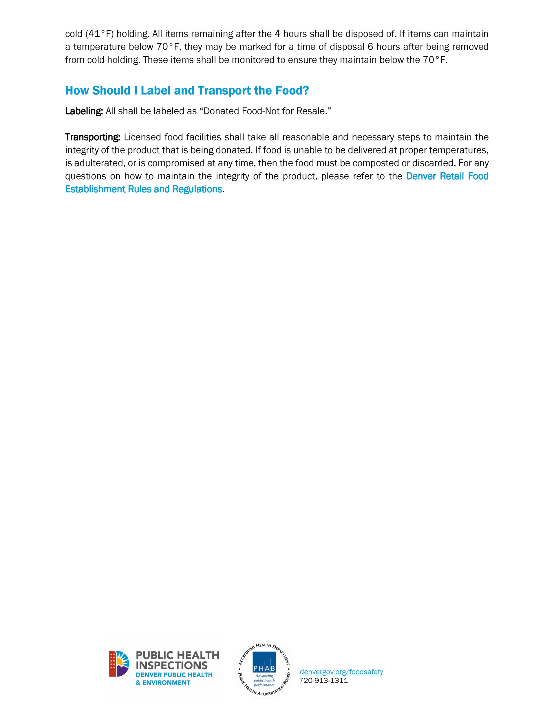
SAFE FOOD DONATION TECHNICAL GUIDANCE
Outreach:
  Tell all food facilities that safe food donation technical guidance is available online
Guidance includes:
  Overview of food waste and food insecurity
  Liability protection information
  What kinds of foods can be donated
  How facilities can keep food safe
  Definitions of terms
  Food temperature monitoring rules
  Suggestions for labeling and transport
How this document can be formatted for your city
How to use this document/talk through it with food facilities
Notes:
Presenter Notes: These talking points should be modified based on whether your department has already created these materials or plans to create them.
Talking Points: Along with the brochure, we also have a technical guidance that will be/is posted on the city’s website. That’s where facilities can find information on all of the local regulations that relate to food donation – like time and temperature controls and requirements for food labeling and transportation -- in one easy place. Please tell all food facilities that this safe donation technical guidance is available online when you hand out the safe food brochure during inspections and trainings.

Slide 32
RECORDING DATA
During your inspections, in addition to providing outreach materials, record the following notes:
How many copies of each material you passed out
Whether you provided verbal education to food facilities
If the food facility donates or plans on donating in the future
Any specific questions that the facility might have had
How much and what food was disposed of if there was a mandatory disposal
Notes:
Presenter Notes: Since every city will vary in how they collect and record data related to this strategy, you will need to fill this slide in based on what you would like for your inspectors to collect. NRDC highly recommends that the department track exactly how many food facilities have received outreach materials and education during inspections. Additionally, if it is possible for inspectors to record how much food is discarded during inspections, this will help with city metrics tracking to test the effectiveness of this strategy. Look at the Guide for tips and pointers on tracking metrics.
Talking Points: The city would like to track the effectiveness of this initiative. To that end, we are asking that you record data during your inspections related to these outreach materials. This is what we would like for you to record during your inspections:
How many copies of each material you passed out
Whether you provided verbal education to food facilities
If the food facility donates or plans on donating in the future
Any specific questions that the facility might have had
How much and what food was disposed of if there was a mandatory disposal

Slide 33
Thank you!
For more information on NRDC’s Food Matters Initiative visit https://www.nrdc.org/food-matters
Notes:
Presenter notes: If there is a city website with more information about city’s food waste reduction efforts, consider including it on this slide for attendees who would like more information.
Talking Points: I’d like to thank you for participating in this training and for working with your facilities to help them donate food safely. We look forward to working with you to help make that possible and we thank you for your time. Please let XX know if you have any questions. If you’d like to learn more about city initiative to reduce food waste or NRDC’s Food Matters project, you can check out the websites on the screen.

